Slide 1
Hunter Cheyne-Stokes Respiration
Treatment
Pro and Con

Slide 2
History
A 94 year old woman with history of left sided heart failure
She suffered from dyspnea and admitted in CCU for 5 days
Cardiologist start treatment of heart failure and she discharge from hospital.
Lab exam : CBC normal Cardiac enzyme :Normal
Echocardiography :EF;30%
Pap 40 mmhg

Slide 3
Her daughter and her nurse have reported witness apnea
Cardiologist referred her to do PSG
PSG in hospital was carried out and the result has shown :
Brief report as bellow
Fragmented Sleep
Stage 1(60%0,2(25%),3(10%),Rem(15%) were seen in the hypnogram

Slide 4
AhI:45/h
%54 central hypopnea, Central cycle is more than 43 second
46% Obstructive Apnea ( 6/h Obstructive apnea, 40/h Hypopnea)
PLMs and Leg movement: 0
Arousal index: 67/h

Slide 5
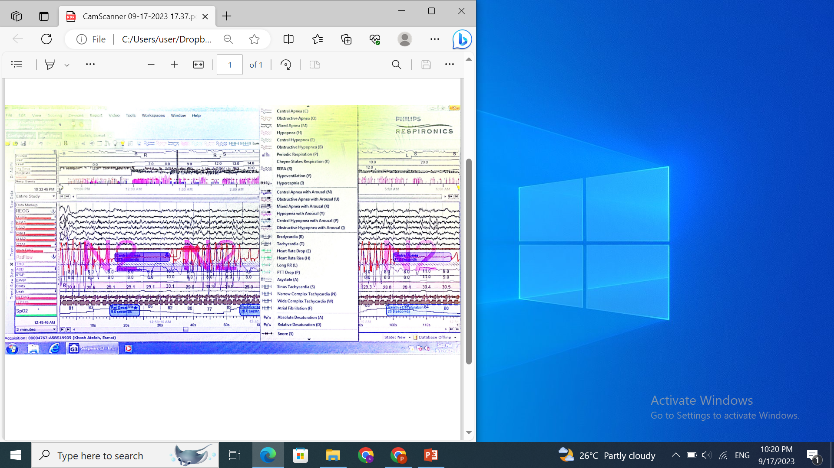

Slide 6
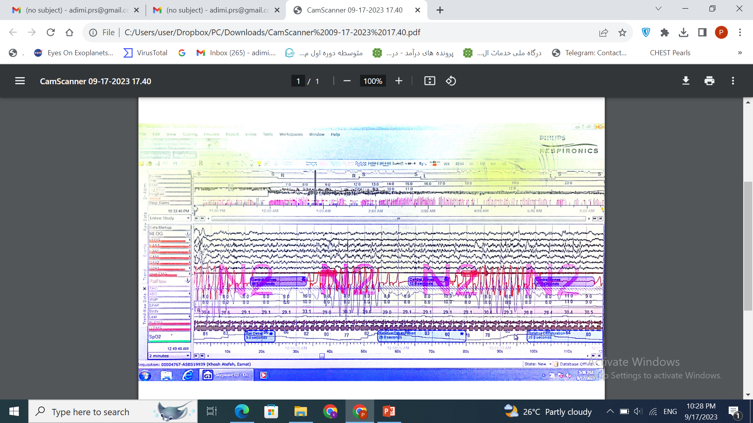

Slide 7
Cpap and Oxygen was started with no befit and BIPAP St can not control of the respiratory events
Patient and family were satisfied from the titration in spite of optimum treatment was not completed.
Considering the situation of the patient and request of her family Adaptive servo ventilation BIPAP for one week trial was borrowed.

Slide 8
Considering the trial of Servo-HF there is contra indication for ASV device
Cardiologist gives the permission because he has believed that during dyspnea and tachycardia the estimation of ejection fraction may not be correct.
Cr;1.8 and k;4.5 acetazolamide was not prescribed for the patient .

Slide 9
report
The result of one week trial of Adaptive servo-ventilation as bellow:
Psmax 8 psmin3 rate automatic
AHI:16/h hypopnea 16/h Apnea:0
Compliance hours:2;45

Slide 10
Considering New trial that was reported in ERS
Milan 2023
Dr. Douglass Bradly 2023 told:

Slide 11
Advent HF trial
key findings were that in the 731 patients that we analysed, the group randomised to the device had a marked reduction in their apnea hypopnea index. So it completely got rid of their sleep apnea over the entire five year course of the trial.
Predictors of 1-year compliance with adaptive servoventilation i

Slide 12
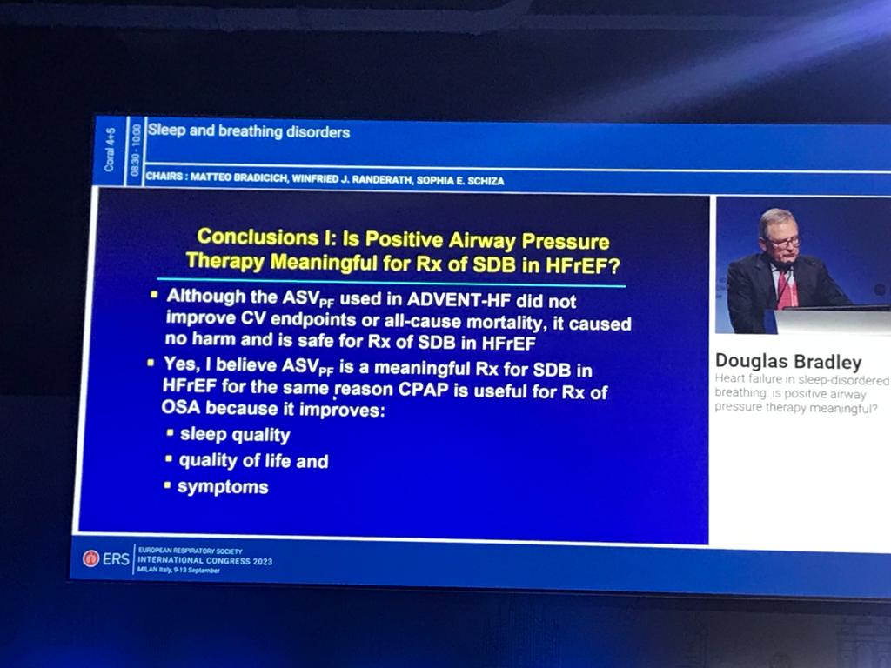
Trial

Slide 13
Summary
Adherence to sleep apnea treatment is essential to evaluate trials involving cardiovascular end-points. In patients with heart failure and obstructive or central sleep apnea in the ADVENT-HF trial, adherence to adaptive servoventilation was very good.

Slide 14
