Slide 1


Thank you for viewing this presentation.
We would like to remind you that this material is the property of the author.
It is provided to you by the ERS for your personal use only, as submitted by the author.
© 2022 by the author

Slide 2










































Real-Time Image-Guided Interventions in Pleural Disease
Dr Rahul Bhatnagar
Bristol, United Kingdom

Slide 3
Aims / Learning objectives
To describe the indications for real-time pleural intervention
To demonstrate the method of real-time intervention
To highlight potential complications

Slide 4
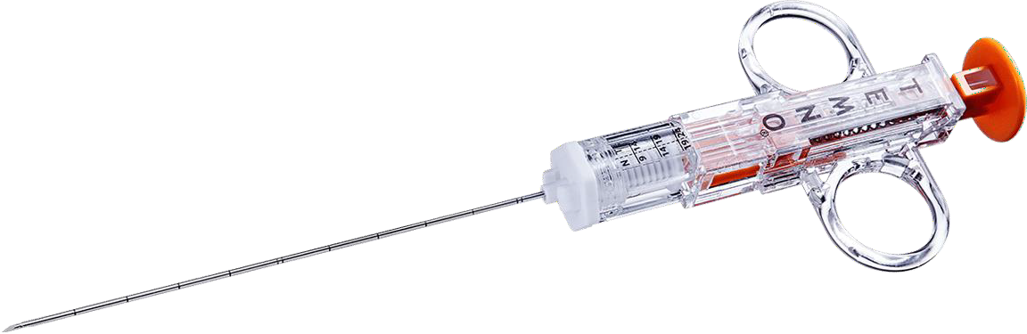
Types of Procedures
Targeted needle / wire / drain placement
Pleural biopsy
  Cutting (core) needle
  [Abram’s biopsy needle] [1]

Slide 5
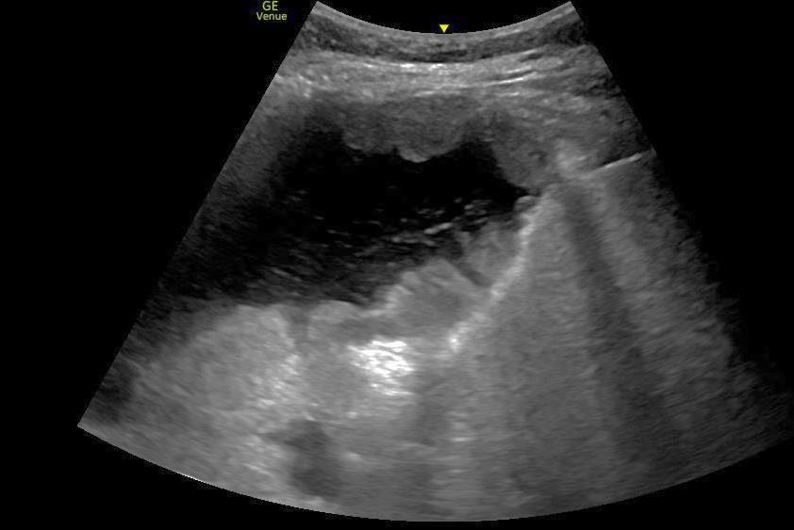
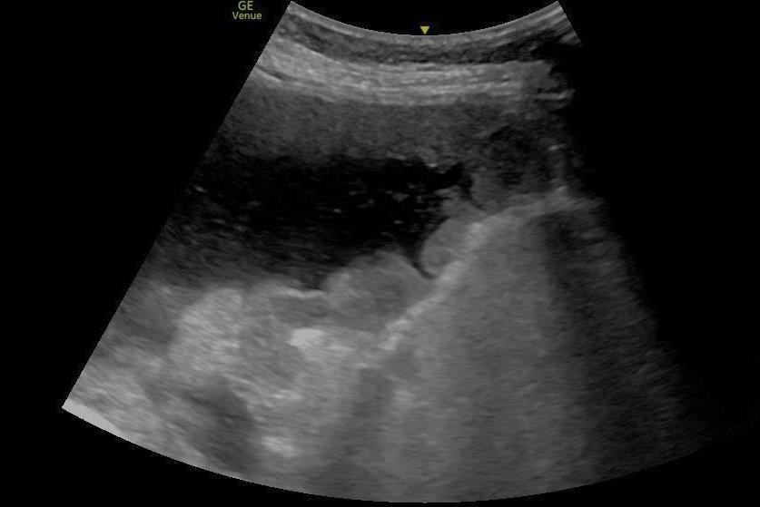
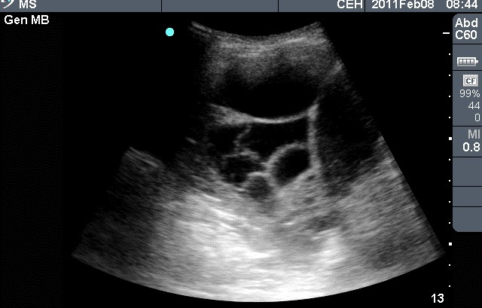
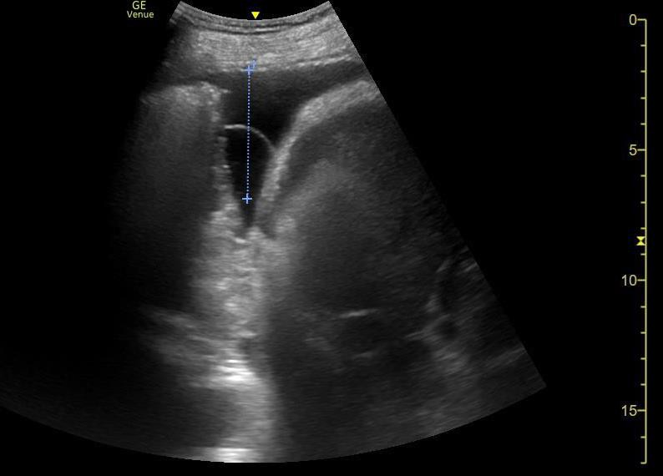

Common Indications
Suspected malignancy
  Pleural mass biopsy
  Pleural thickening biopsy
  High yield, consider if failed LAT [2]
Drainage in difficult pleural space
  Complex pleural effusion
  Small volume effusion
Pleural infection
  Pleural biopsy shown to increase diagnostic yield [3]
  Can be done at same time as tube insertion
*
*
Induction of pneumothorax in small effusion

Slide 6
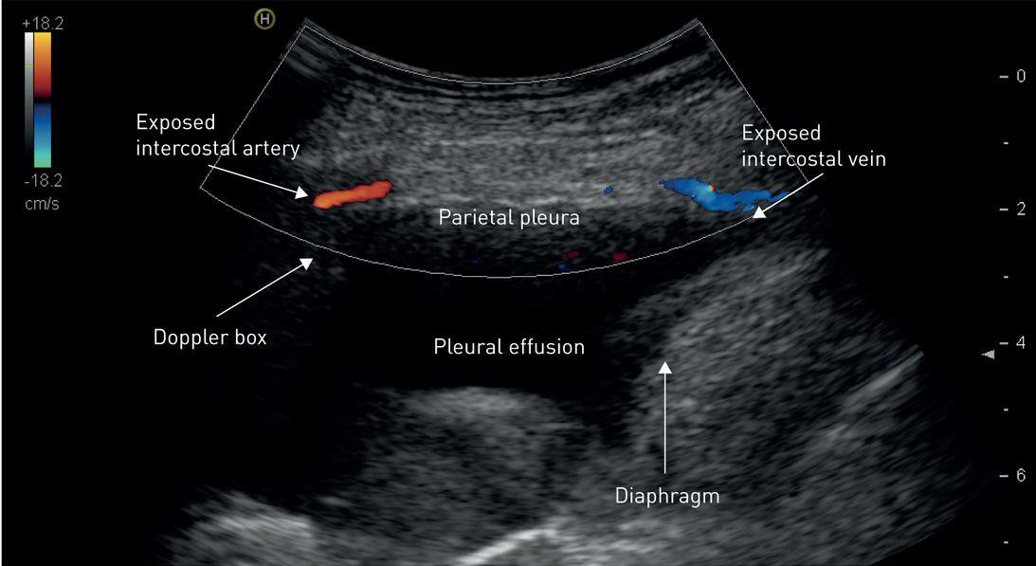
Contraindications
Lack of pleural fluid
Unable to visualise area to be biopsied
Patient unable to tolerate safe position
Vulnerable intercostal artery [4]
Anticoagulation / low platelets / bleeding tendency
NB. Significant obesity increases likelihood of
  Poor image quality
  Anaesthetic not reaching pleura (angled approach)
  Interventional needle not reaching pleura

Slide 7
Consent
Consent for
  Failure
  Pain
  Bleeding needing treatment
  Pneumothorax (4%)
  Wound infection (3%)
  Pleural infection (<1%)
  Organ puncture / damage
  Non-diagnosis

Slide 8
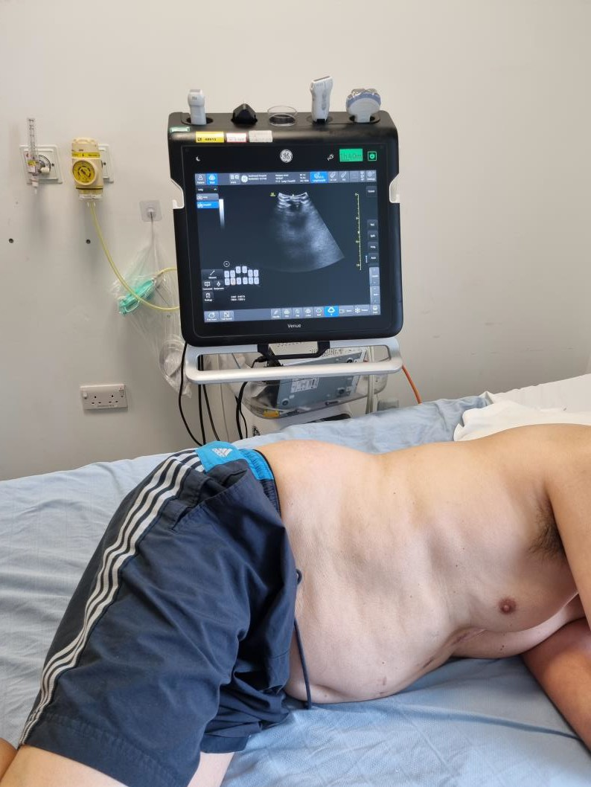
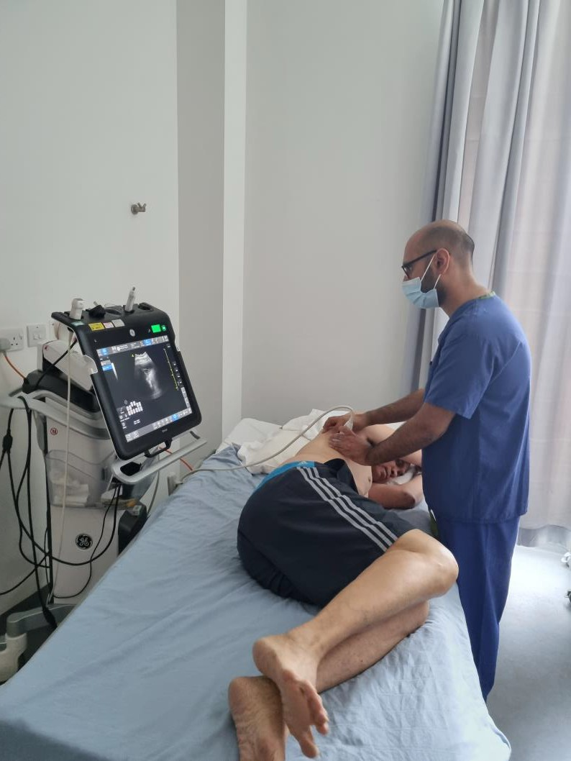
Positioning
Patient ideally
  lateral decubitus
  mid-axillary line
But can be any position as long as safe and comfortable
Operator ideally
  Comfortable height
  Direct line of sight to US

Slide 9
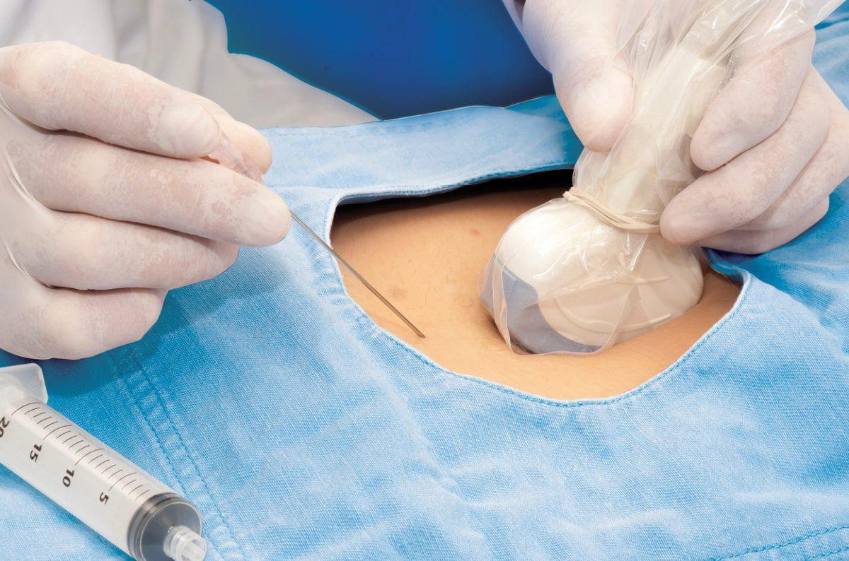
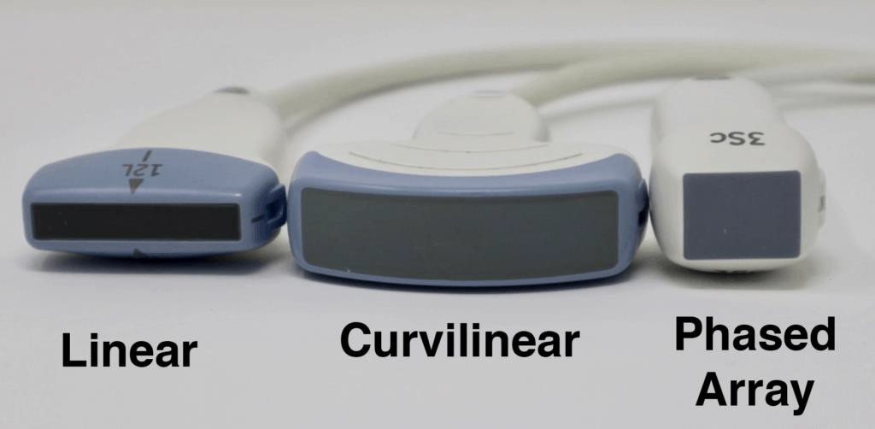
Equipment and Room Preparation
‘Clean’ room / area
Assistant!
Curvilinear probe
  Low frequency (2-5 MHz)
  Provides wide US beam and depth of view
Probe sheath
Sterile gel on patient

Slide 10
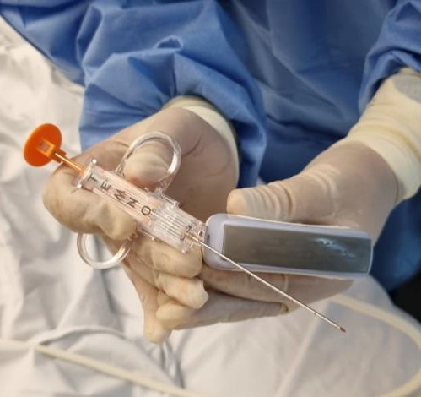
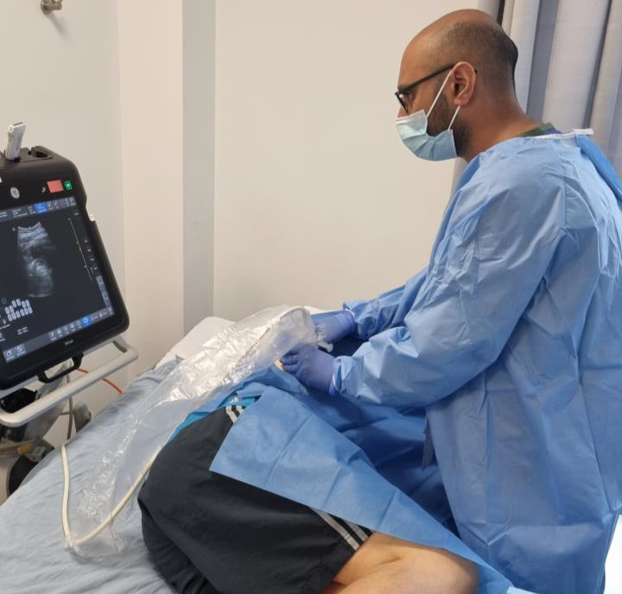
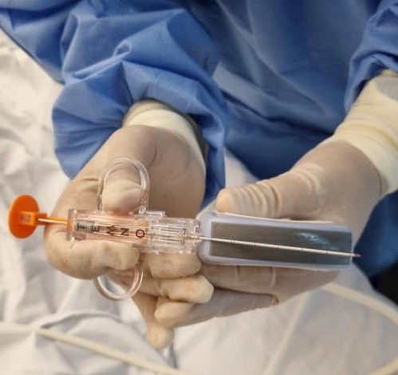
Probe and Needle Orientation
Needle in dominant hand
Ensure approach angle of needle is kept
within plane of ultrasound beam
Move either needle or probe, not both
Probe ideally orientated parallel to rib
Needle close to probe
Look at screen, not hands

Slide 11
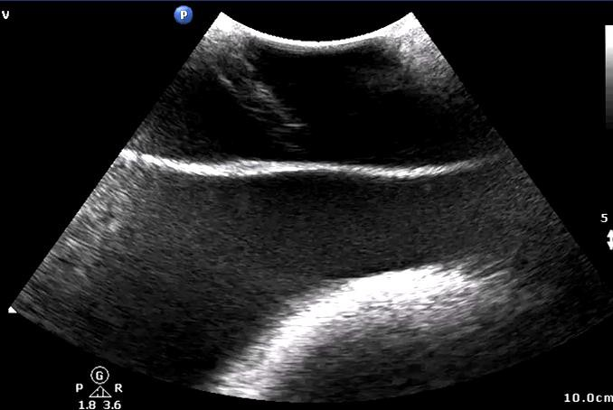
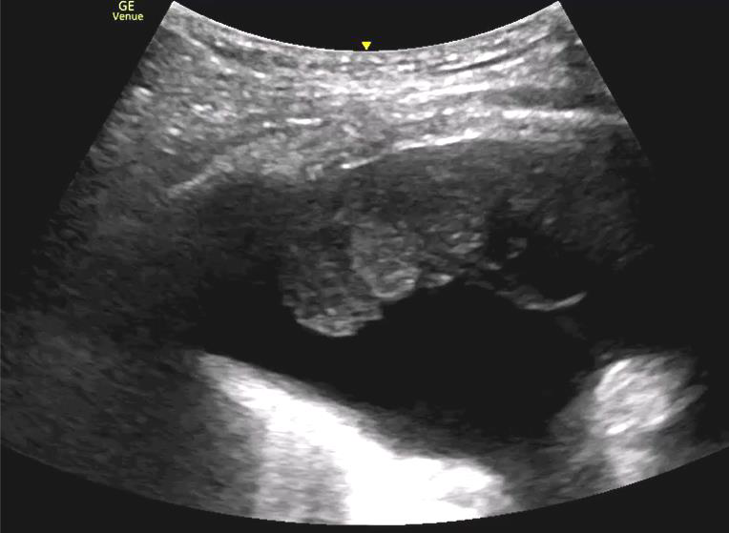
Tracking the Needle / Instilling Local
‘Bounce’ needle while advancing to identify position
Target anaesthetic just above parietal pleural layer

Slide 12
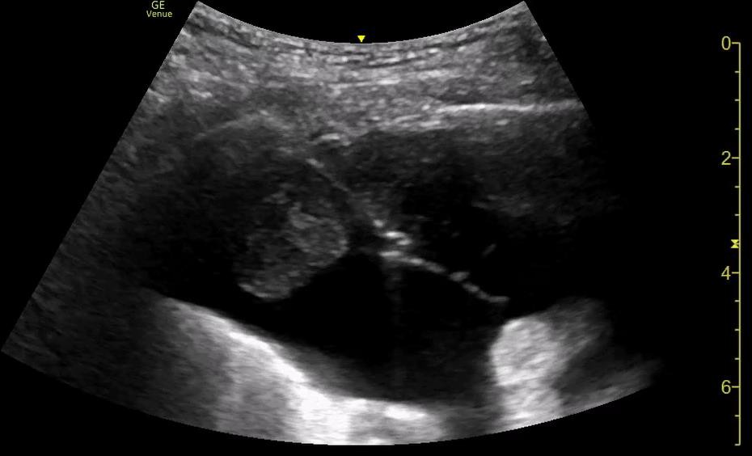
Pleural Biopsy
Aim for inferior site (closer to diaphragm) if possible [5]
Aiming for oblique biopsy crossing pleura
  Less important if targeting mass
Pleural tumour
Be aware of sampling section size

Slide 13
Checking for Complications / Post Procedure
Scan +/- doppler after each biopsy
taken
‘Oozing / dripping’ from biopsy site within fluid is normal
  Not the same as intercostal bleed!
Assess for external haematoma formation
Meta-analysis data (>1300
patients) [6]
  Major complications 1%
  Minor complications 2%
Dressing +/- suture
Basic vitals measurements

Slide 14








































Lung ultrasound in the diagnosis and management of respiratory failure
Casper Falster
MD, Ph D- student
Odense Respiratory Research Unit Denmark

Slide 15

Quiz time
Which of the following conditions are not detectable using lung ultrasound?
Pulmonary edema
Exacerbation of COPD
Interstitial lung disease
Viral pneumonia
Lung contusion
25107

Slide 16
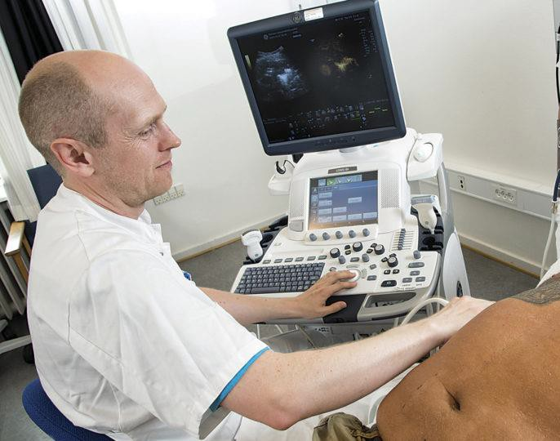
Focused lung ultrasound
Frequently used in the acute setting
Several indications:
Dyspnea
Chest pain
Objective signs of respiratory failure
Suspected pulmonary or thoracic infection
Trauma

Slide 17
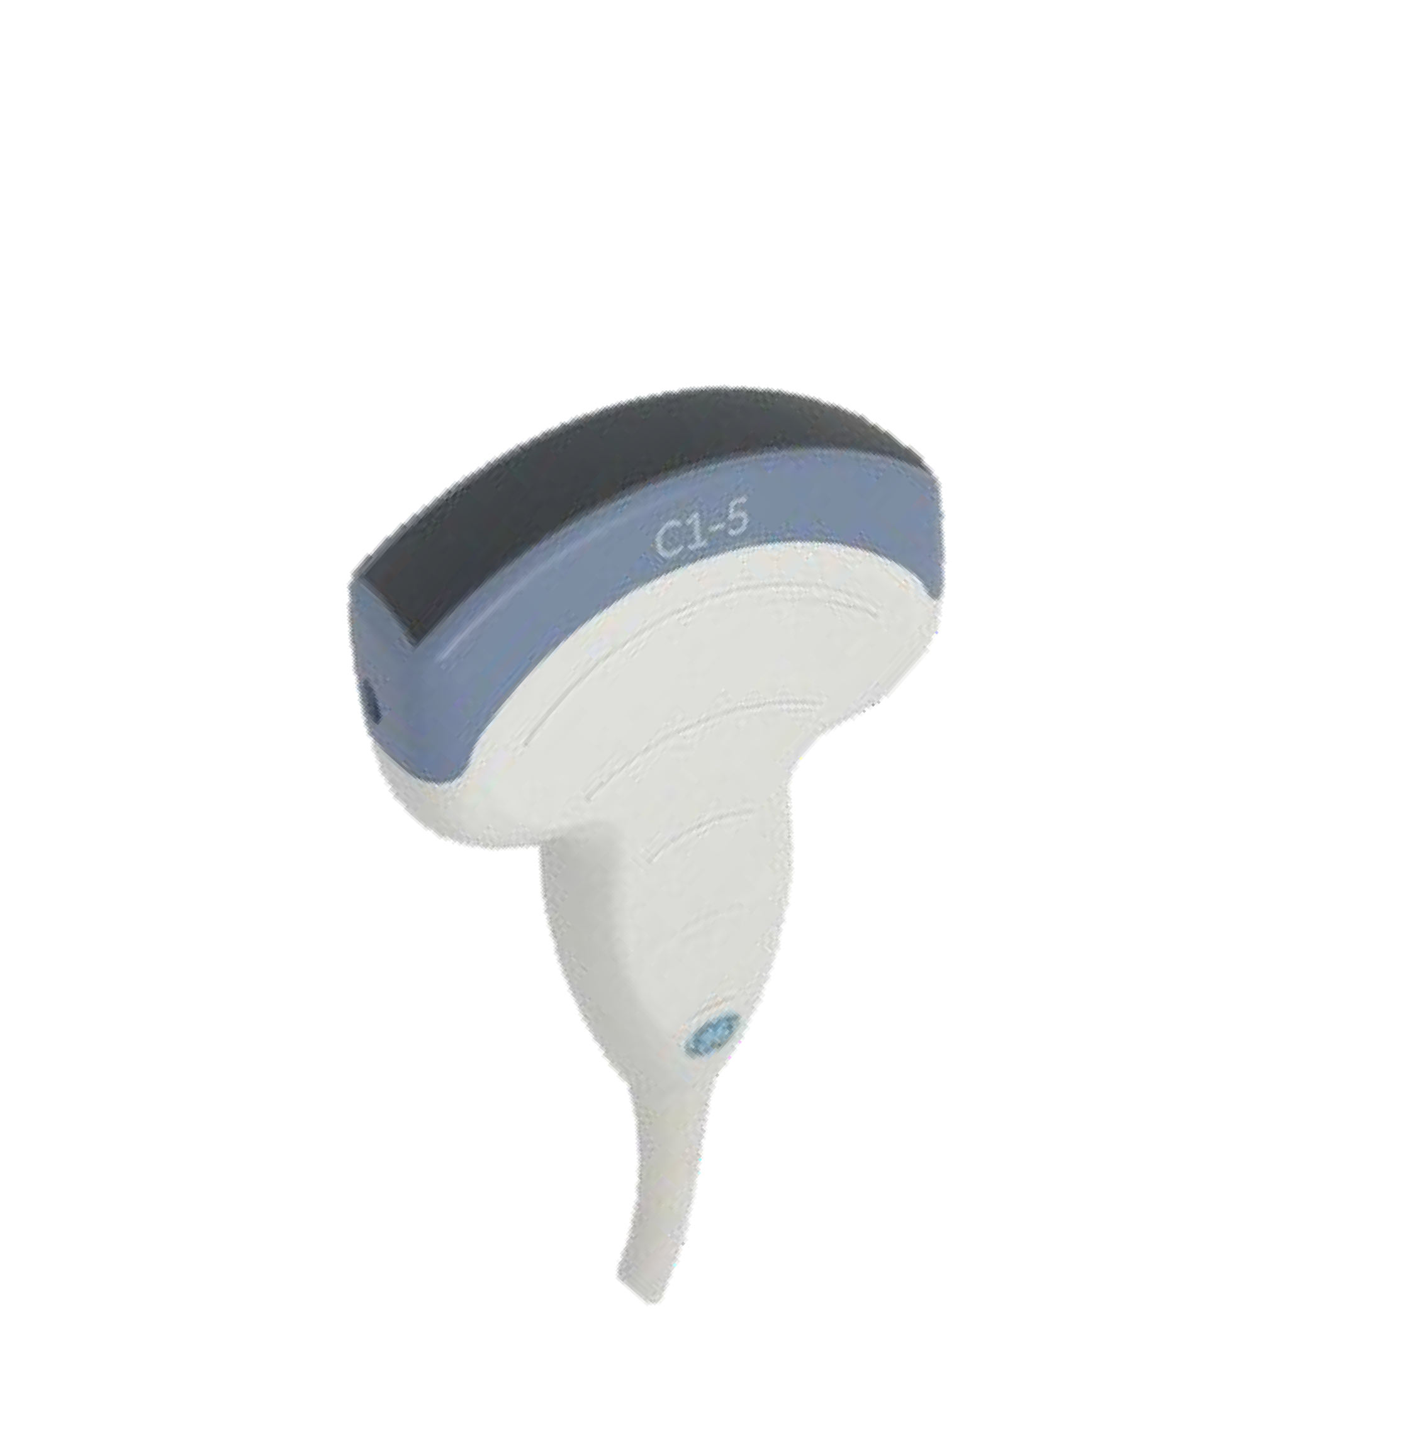
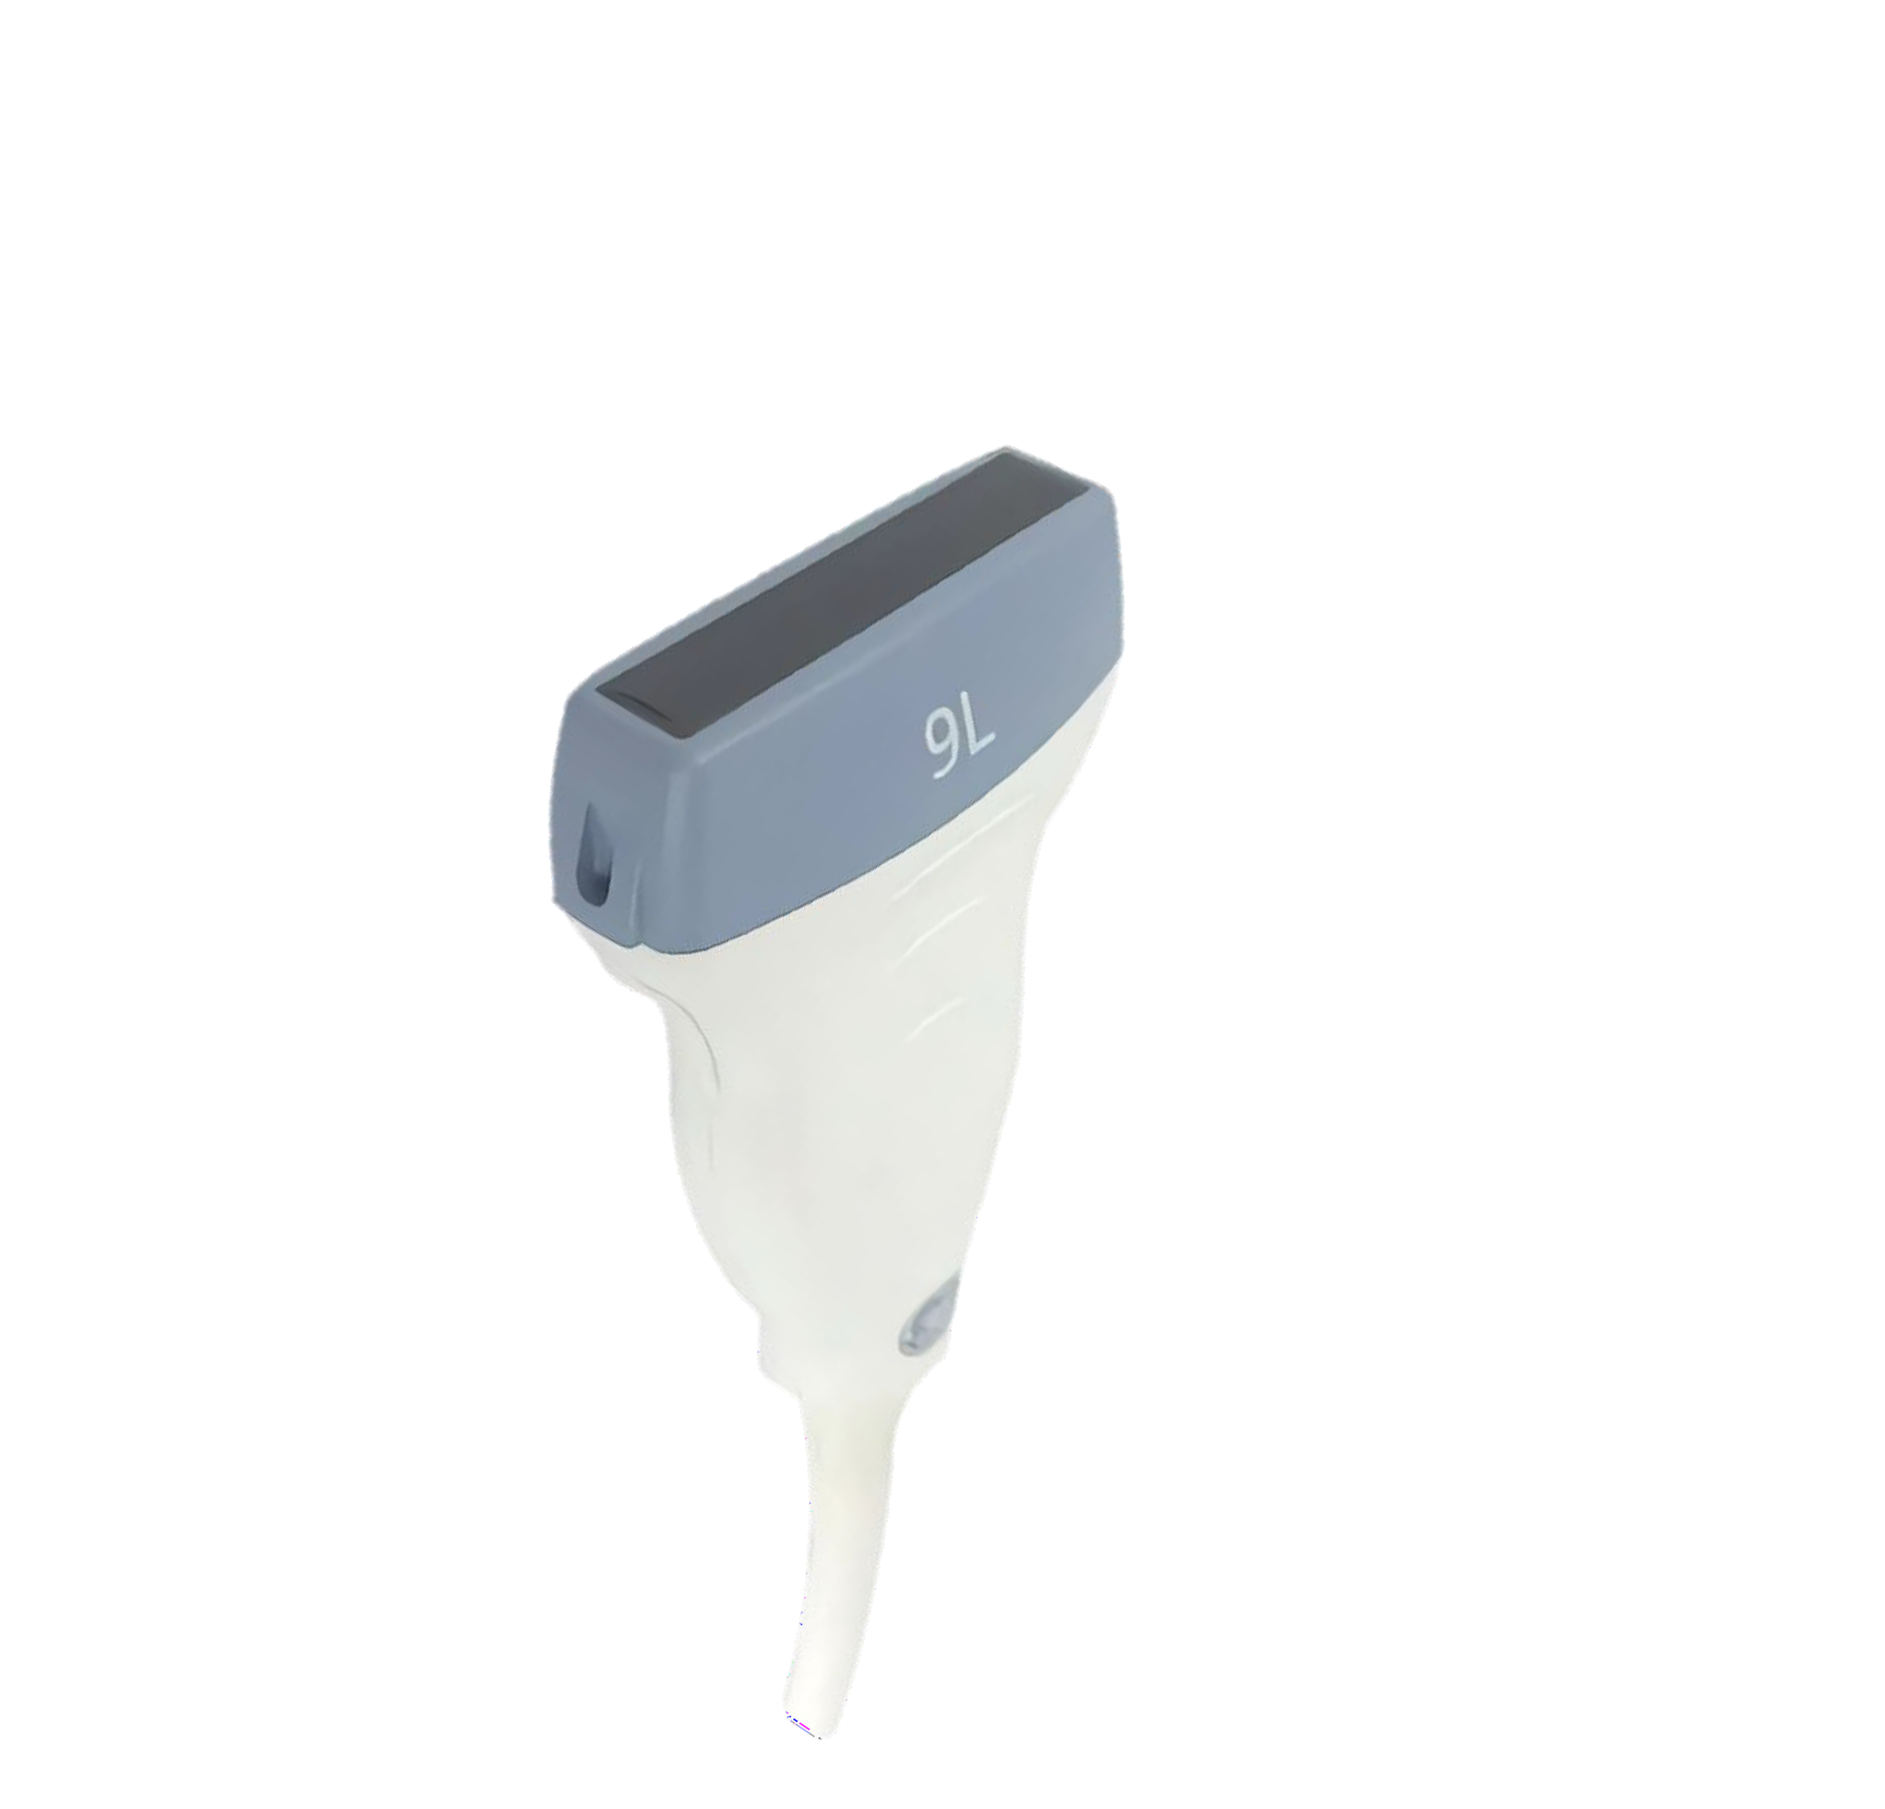
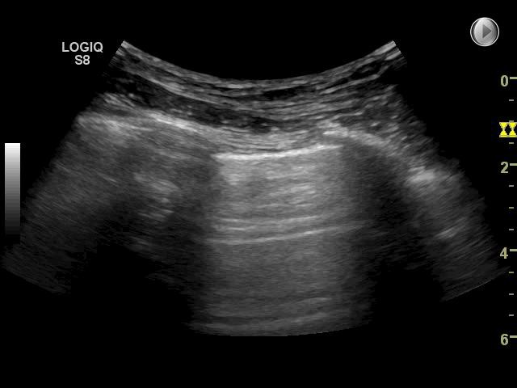
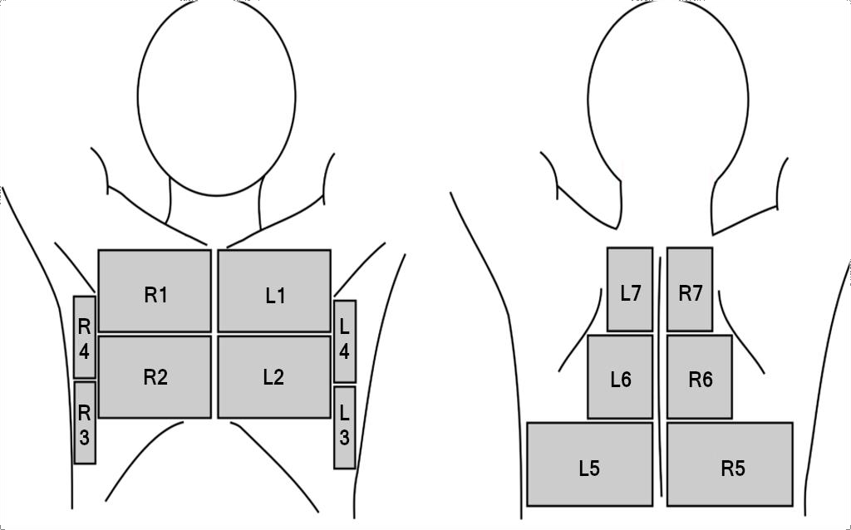
Focused lung ultrasound
14 zones
Using the curved probe

Slide 18
BLUE PROTOCOL

Slide 20
Zones R1 and L1
The transducer should be placed in the second ICS a few centimetres lateral to the sternum.
Zone findings: these resemble the basic sonoanatomy pattern
Zone R2
The transducer is moved to ICS4 a few centimetres lateral to the sternum.
The anatomical landmark is the lower edge of the pectoralis muscle or breast tissue. In most persons, this point corresponds to the anterior phrenicocostal sinus, and both the pleural line and the superficial part of the diaphragm can be visualised
Zone findings: zone R2 findings consist of the pleural line on the left of the screen and the diaphragm and liver on the right of the screen.
Zone L2
The transducer should gradually be moved caudally one ICS at a time until the pericardium and heart appear on the right side of the screen
Zone findings: zone L2 findings consist of the pleural line on the left of the screen and the pericardium and heart on the right.

Slide 21
Zone R3
The transducer in the midaxillary line on the lower part of the chest
Zone findings: zone R3 findings consist of the pleural line on the left of the screen and abdominal structures on the right of the screen
Zone L3
The transducer in the posterior axillary line on the lower part of the chest
Zone findings consist of the pleural line on the left of the screen and the
spleen (and left kidney) on the right of the screen

Slide 22
Zones R4 and L4
The transducer should be placed in approximately ICS3 in the
midaxillary line
Zone findings: zone 4 findings on both sides resemble the basic pattern
Zones R5 and L5
The transducer at the lower part of the chest at a vertical line corresponding
to the tip of the scapulae (inferior angle).
Zone findings: zone R5 findings consist of the pleural line on the left of the screen and the liver and upper abdominal structures on the right of the screen.

Slide 23
Zones R4 and L4
The transducer should be placed in approximately ICS3 in the
midaxillary line
Zone findings: zone 4 findings on both sides resemble the basic pattern
Zones R5 and L5
The transducer at the lower part of the chest at a vertical line corresponding
to the tip of the scapulae (inferior angle).
Zone findings: zone R5 findings consist of the pleural line on the left of the screen and the liver and upper abdominal structures on the right of the screen.

Slide 24
Zones R6 and L6
Transducer placement: the transducer is placed in the posterior midclavicular line at a level
corresponding to the middle part of the scapulae. The best images can generally be
obtained by placing the transducer as close to the medial border of the scapulae as possible.
An additional area of the pleura can be assessed in zone 6 if the patient is asked to place
the hand of the side being scanned on the opposite shoulder, causing the scapula to move
and rotate laterally.
Zone findings: the basic sonoanatomy pattern
Zones R7 and L7
Transducer placement: the transducer is placed in the posterior midclavicular line at a level
corresponding to the cranial part of the scapulae. The best images can generally be
obtained by placing the transducer as close to the medial border of the scapulae as possible.
An additional area of the pleura can be assessed in zone 7 if the patient is asked to perform
the same manoeuvre as described for zone R6/L6
Zone findings: the basic sonoanatomy pattern

Slide 25
7 Lung ultrasonographic charactristics
1-The thorax is an area where air and water are intimately mingled.
2-The lung is the largest organ in the human body.
3-All signs arise from the pleural line
4-Lung signs are mainly based on the analysis of the artifacts.
5- The lung is a vital organ. Most signs are
dynamic.
6-Nearly all acute disorders of the thorax come in contact with the surface. This explains the potential of lung ultrasound, which is paradoxical only at first view.
7. A simple method is suitable for lung ultrasound. A two-dimensional unit without filters or facilities is the most appropriate

Slide 26
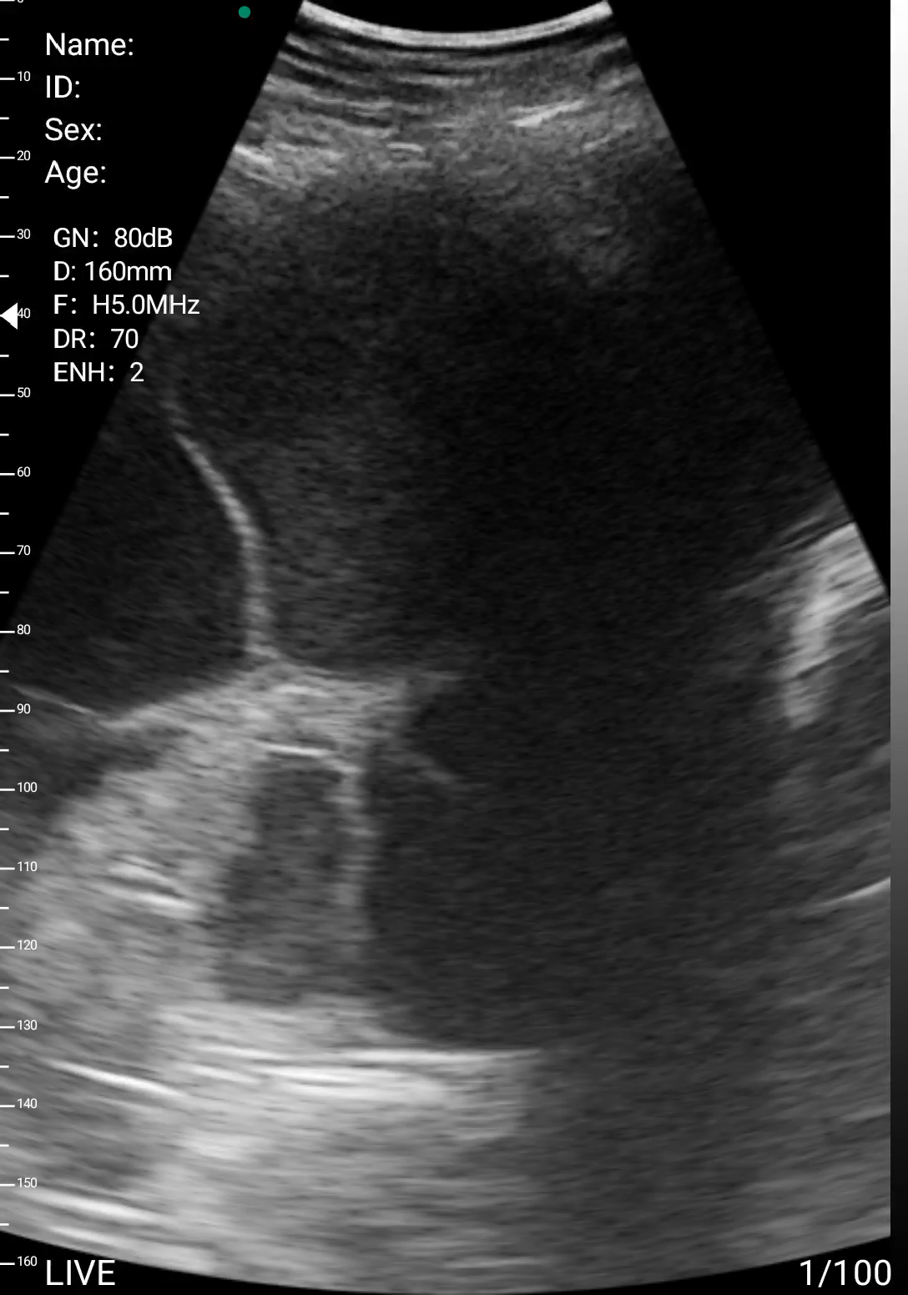
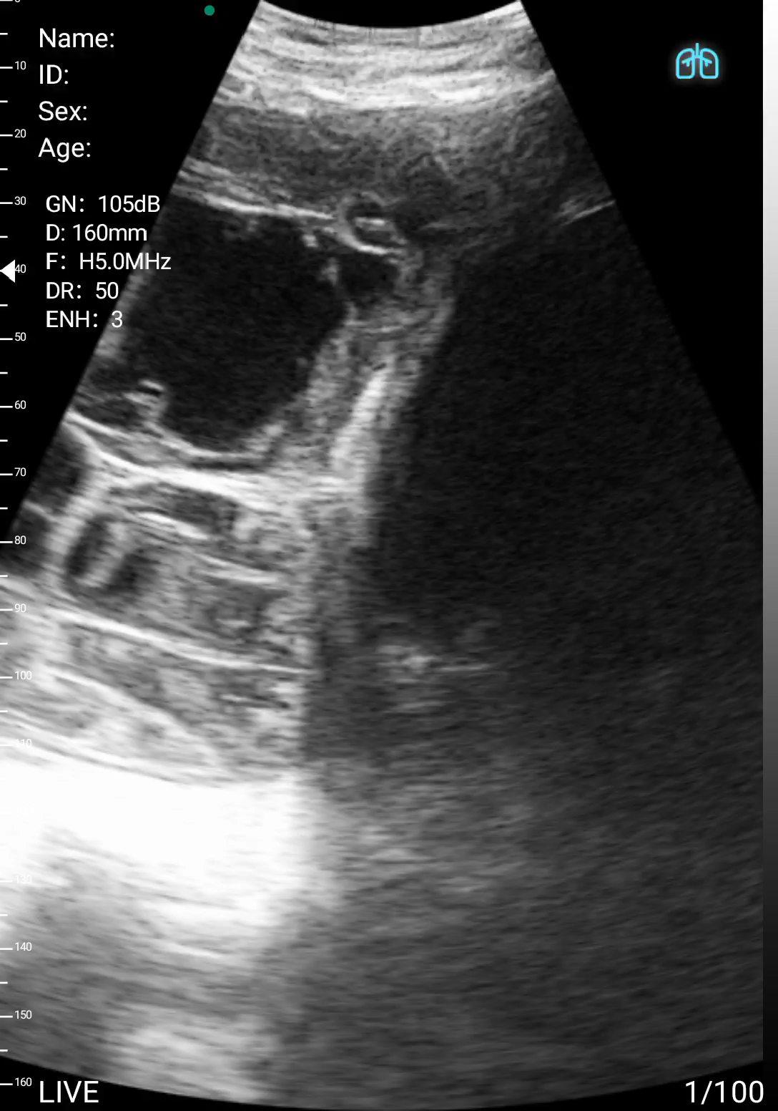

Slide 27
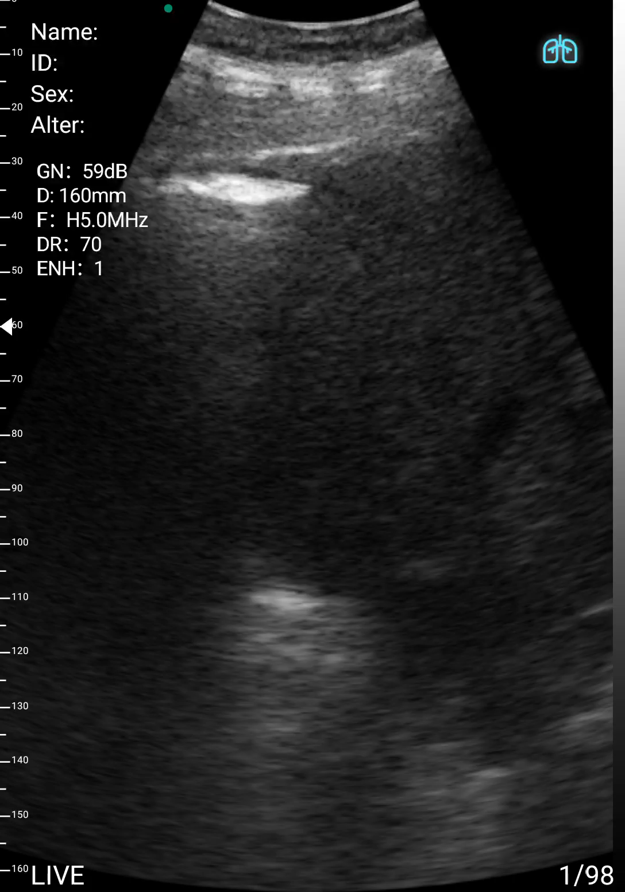
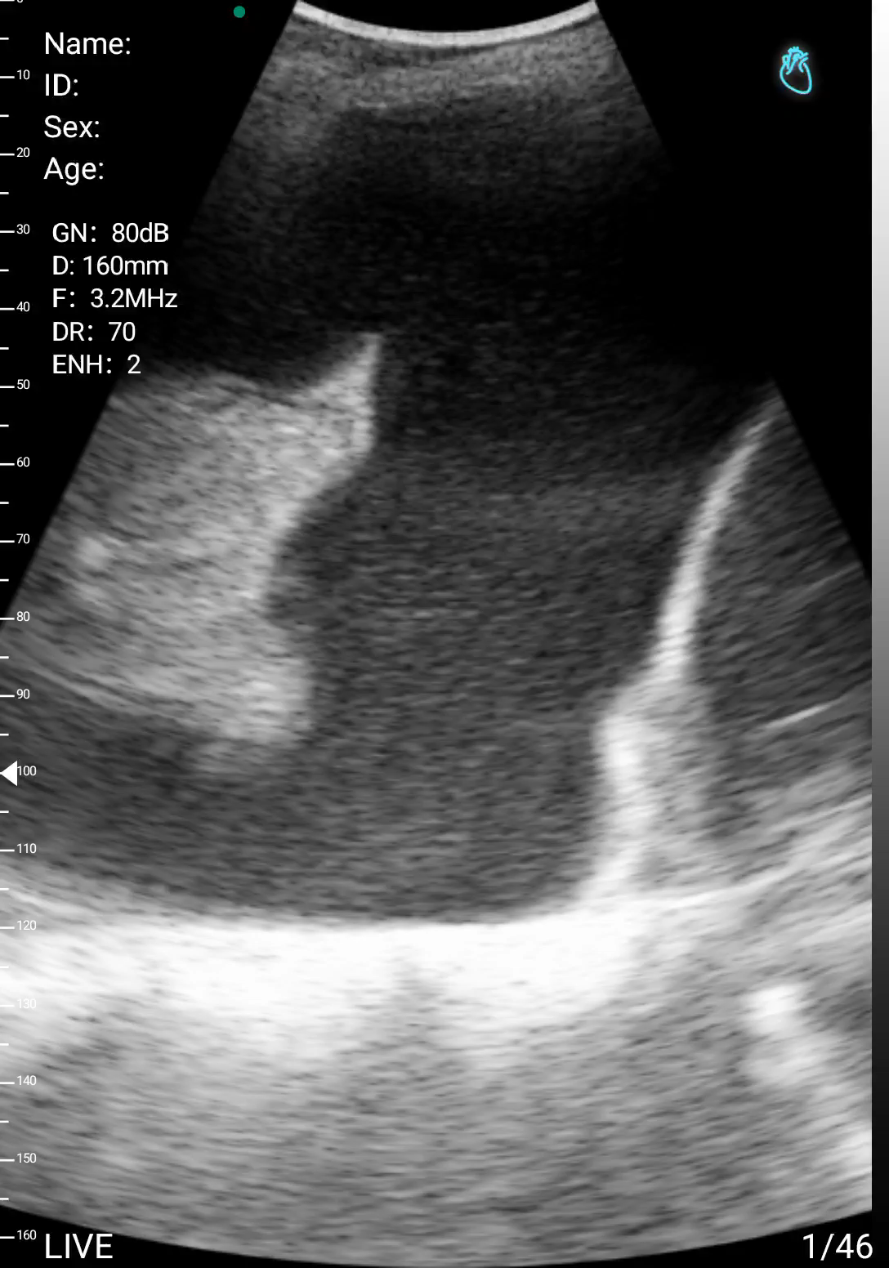

Slide 28
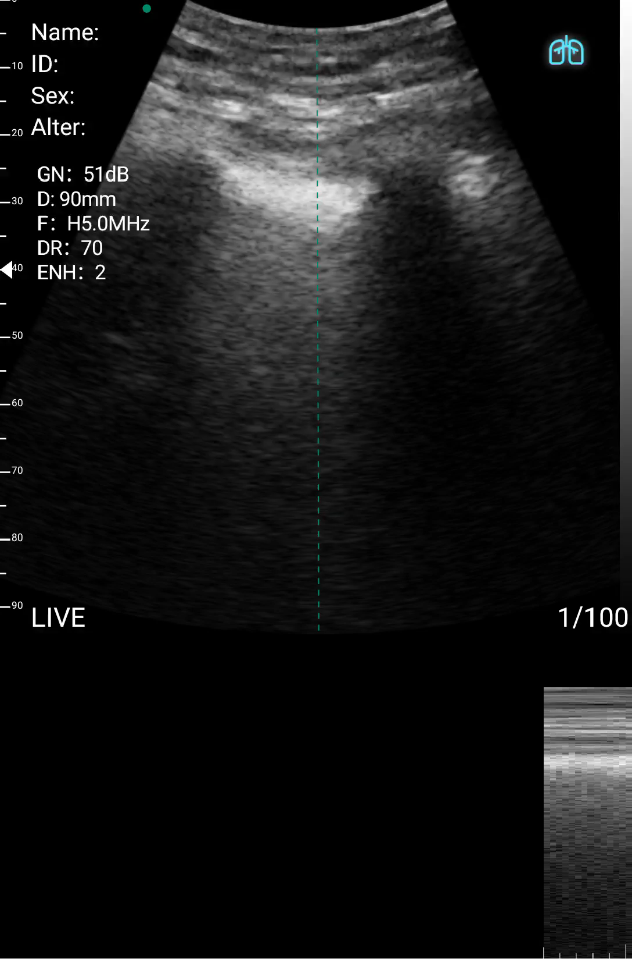

Slide 29
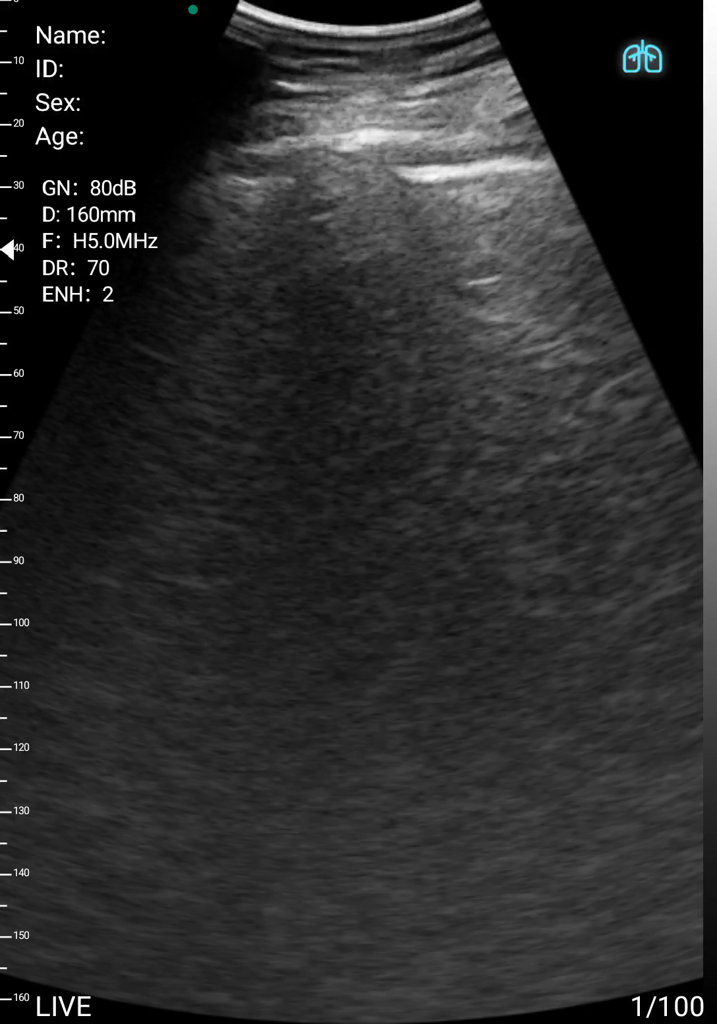

Slide 30
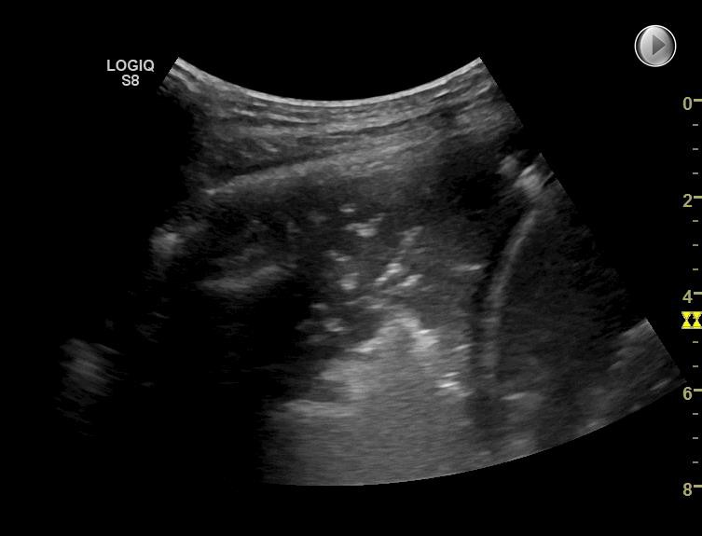
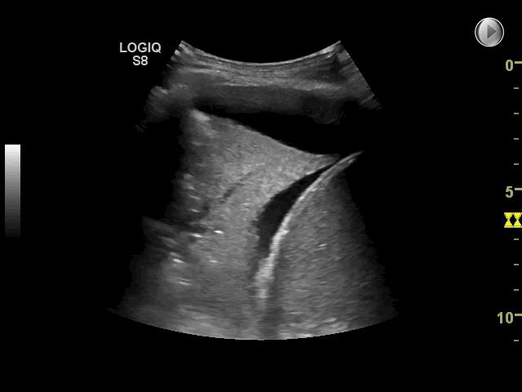
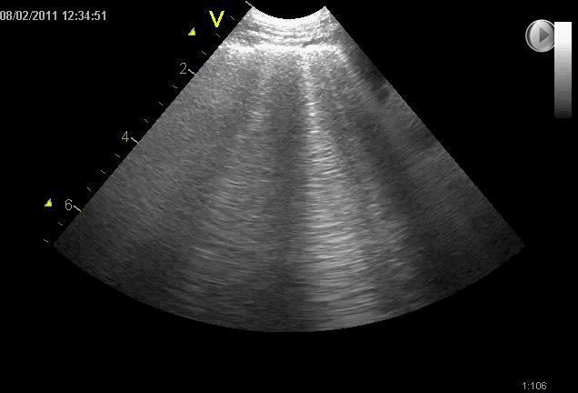
Focused lung ultrasound
Considers presence or absence of four common clinical problems:
Pneumothorax
Pleural effusion
Interstitial syndrome
Gross pathology

Slide 31
Online Skills Lab: Thoracic Ultrasound
Transthoracic Ultrasound: Contrast enhanced ultrasound in lung and pleural disease
5th September 2022
Dr. Eihab Bedawi
Clinical Research Fellow in Pleural Disease Oxford Respiratory Trials Unit
University of Oxford, Oxford, United Kingdom
With thanks to Professor Christian Laursen, Odense University Hospitals, Odense, Denmark

Slide 32
Aims / Learning objectives
Principles of CEUS and ultrasound contrast agents
Uses of contrast enhanced thoracic ultrasound in lung/pleural pathology
How to do it
Some example cases

Slide 33
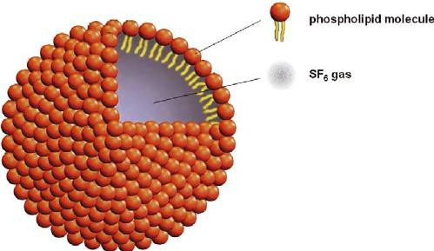
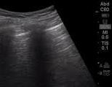
CEUS principles
Microbubble based contrast agents
Low mechanical index imaging to prevent
bubble burst (MI <0.1 – 0.3)
Real-time evaluation of lesions – removes circulatory variation as a factor in the ability to achieve optimal imaging – can examine all phases of enhancement rather than a snapshot in CT

Slide 34

Why is the lung suited to CEUS?
Lung – dual blood supply
  Pulmonary arteries responsible for gas exchange
  Bronchial (systemic) arteries supplies the lung parenchyma and visceral pleura
  Different tissue enhancement – PA enhancement starts before BA so if you have tissue with a dominant PA supply it should be earlier and more marked
Chest wall
  Chest wall tumours vascularised via neoangiogenesis arising from the systemic (intercostal) arteries
Pleural
  Pleural based benign lesions can get supply from both arterial systems
  Tumour angiogenesis usually arises from the bronchial arteries

Slide 35
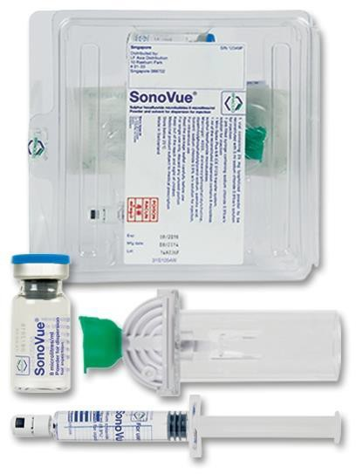
Ultrasound contrast agents
Different to CT/MRI
Short half-life (approx. 5 mins)
Same size as RBCS so can pass through capillary beds
Stay in circulation without diffusion into the interstitium – ‘true blood pool’ agent
Safe for patients with impaired renal function
Safe in patients with allergy to iodinated/gadolinium based contrast agents
Claustrophobic patients who cant get into CT or MRI

Slide 36
Ultrasound contrast agents
Safety
Anaphylactoid reactions 1:7000 (0.014%); far lower than modern iodinated CT contrast agents – approx. 35-95:100,000 (0.035-0.095%)
Serious reactions can occur in approx. 1 in 10,000
Side effects
  Pooled data from 75 studies (n=6307):
    Headache (2.1%)
    Nausea (0.9%)
    Chest pain/discomfort (0.5-0.8%)
Tang C et al. Safety of Sulfur Hexafluoride Microbubbles in Sonography of Abdominal and Superficial Organs: Retrospective Analysis of 30,222 Cases. J Ultrasound Med 2017
Sidhu PS et al. The EFSUMB Guidelines and Recommendations for the Clinical Practice of Contrast-Enhanced Ultrasound (CEUS) in Non-Hepatic Applications: Update 2017. Ultraschall Med 2018

Slide 37
Introduction to the terminology

Slide 38
Enhancement
CEUS phases – arterial / parenchymal
Arterial: earliest arrival of the contrast at the lesion to the peak of contrast enhancement (usually within 30s of USCA injection)
Parenchymal: time from peak contrast enhancement of the lesion to the
washout

Slide 39
Terminology: Enhancement
Time to enhancement (TE) or arrival time (AT)
  Early (PA pattern) - lesion enhances before the systemic arrival in the chest wall/normal lung
  Delayed (BA pattern) - lesion enhances with chest wall/normal lung
Extent of enhancement (EE)
Non-enhancement, hypo-enhancement, iso-enhancement, hyper-
Homogeneity/pattern of enhancement (HE)
Homogenous and inhomogenous
Decrease in enhancement (DE aka ‘washout’)
Rapid (<120s) or late (>120s)

Slide 40
Timing and phase
Pathological lung lesions firstly characterised by TE; arbitrary cut offs of 6-10s from IV bolus however lots of confounding variables; heart/lung/thyroid disease, patient position, site of access, mode of delivery
Use of liver/spleen as a reference in the literature but simultaneous assessment of a lung lesion only possible if basal – chest wall favourable
Avascular lesions with no PA/BA/alternative systemic supply will demonstrate no
contrast enhancement
Lesions strictly located within the chest wall will have a systemic vascular supply from the ICAs ie delayed TE on CEUS

Slide 41
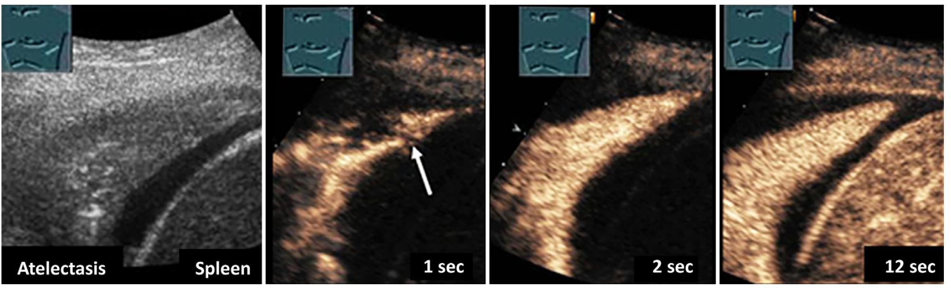
Lung atelectasis
Zadeh et al WFUMB TECHNOLOGICAL REVIEW: HOW TO PERFORM CONTRAST-
ENHANCED ULTRASOUND OF THE LUNG Ultrasound in Med & Biol 2021

Slide 42
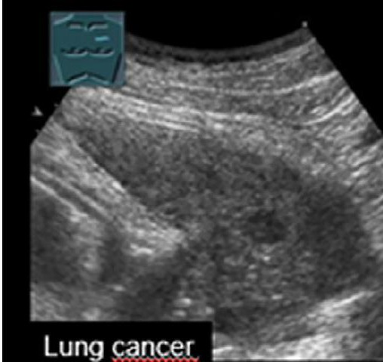
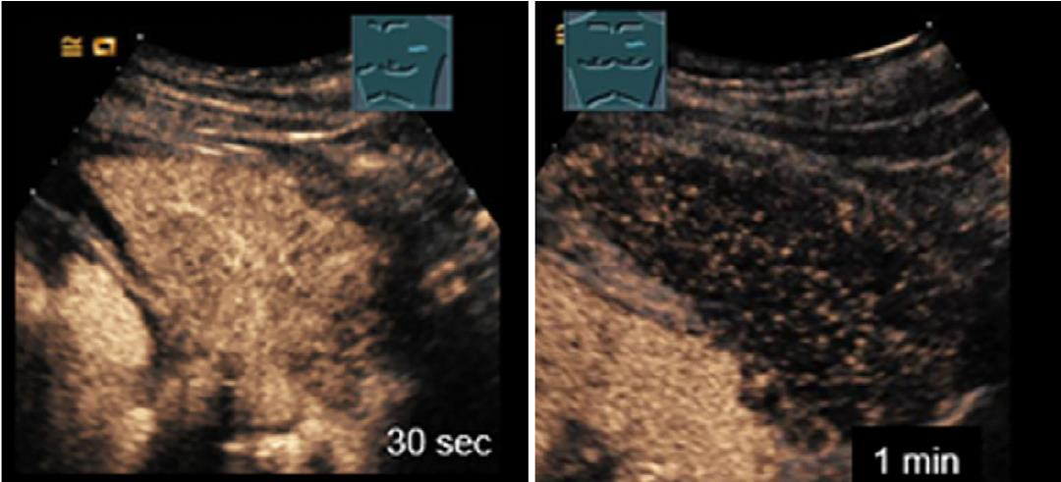
Lung cancer
Zadeh et al WFUMB TECHNOLOGICAL REVIEW: HOW TO PERFORM CONTRAST-
ENHANCED ULTRASOUND OF THE LUNG Ultrasound in Med & Biol 2021

Slide 43
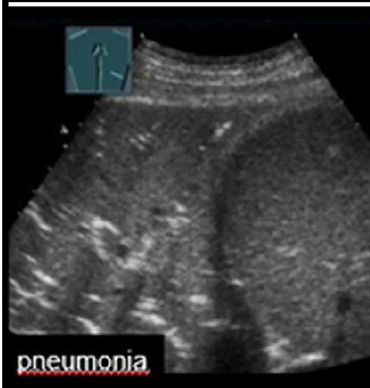
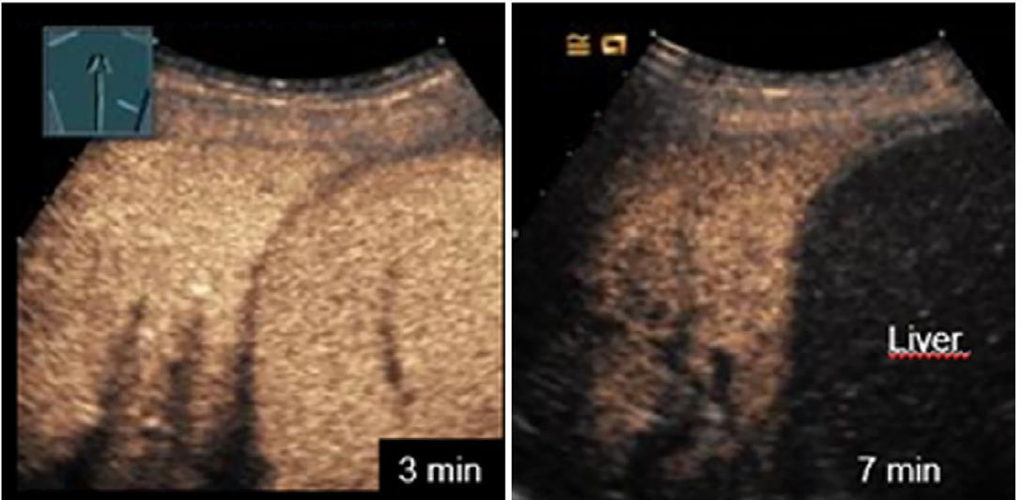
Pneumonia
Zadeh et al WFUMB TECHNOLOGICAL REVIEW: HOW TO PERFORM CONTRAST-
ENHANCED ULTRASOUND OF THE LUNG Ultrasound in Med & Biol 2021

Slide 44
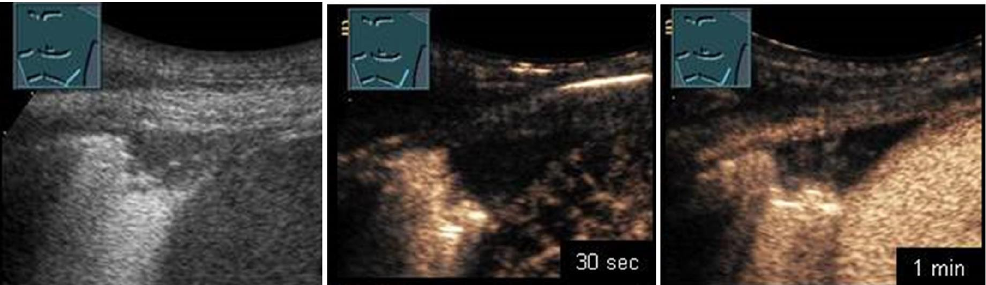
Peripheral infarct
Zadeh et al WFUMB TECHNOLOGICAL REVIEW: HOW TO PERFORM CONTRAST-
ENHANCED ULTRASOUND OF THE LUNG Ultrasound in Med & Biol 2021

Slide 45
Clinical application

Slide 46
EFSUMB 2017 Guidelines and Recommendations: CETUS clinical applications
CEUS is useful in differentiating inflammatory from embolic lung consolidation, especially in patients with equivocal CT findings (Recommendation Level B)
CEUS may be used in equivocal cases to diagnose lung abscesses within pneumonia, as CEUS appears better than conventional B-mode US or X-ray (Recommendation Level C)
CEUS is helpful in performing an ultrasound-guided biopsy of non-necrotic areas in lung lesions and seem to increase the diagnostic yield of the obtained biopsy (Recommendation Level C)
Sidhu PS et al. The EFSUMB Guidelines and Recommendations for the Clinical Practice of Contrast-Enhanced Ultrasound (CEUS) in Non-Hepatic Applications: Update 2017. Ultraschall Med. 2018

Slide 47
EFSUMB 2017 Guidelines and Recommendations: CETUS clinical applications
CEUS is useful in differentiating inflammatory from embolic lung consolidation, especially in patients with equivocal CT findings (Recommendation Level B)
CEUS may be used in equivocal cases to diagnose lung abscesses within pneumonia, as CEUS appears better than conventional B-mode US or X-ray (Recommendation Level C)
CEUS is helpful in performing an ultrasound-guided biopsy of non-necrotic areas in lung
lesions and seem to increase the diagnostic yield of the obtained biopsy (Recommendation
Level C)
Sidhu PS et al. The EFSUMB Guidelines and Recommendations for the Clinical Practice of Contrast-Enhanced Ultrasound (CEUS) in Non-Hepatic Applications: Update 2017. Ultraschall Med. 2018

Slide 48
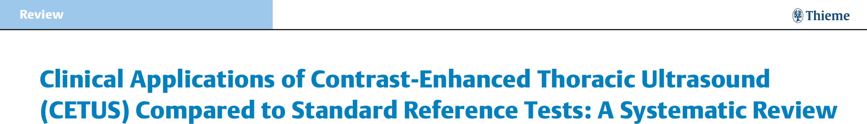
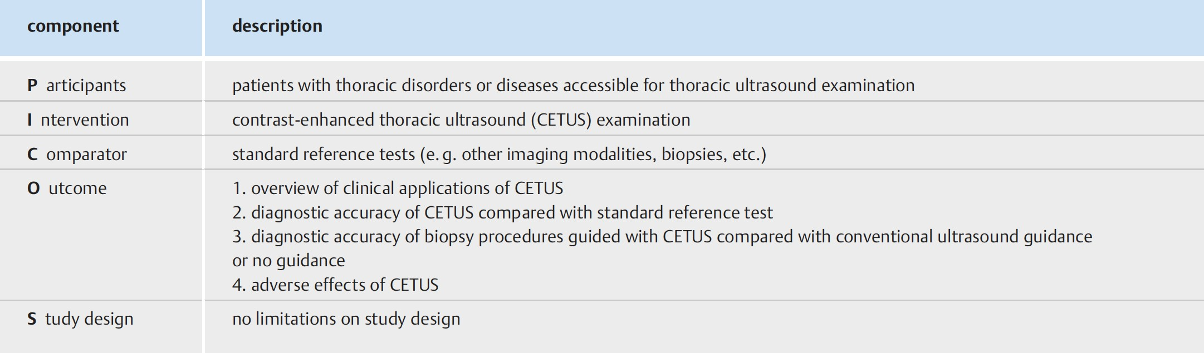
CETUS clinical applications
Jacobsen et al Ultraschall 2020

Slide 49
CETUS clinical applications
42 studies including 1 RCT* and 6 non-randomised controlled studies
Small populations, high risk of bias
Studies too heterogeneous for a meta-analysis
Most frequent application of CETUS was guidance during biopsy procedures of pulmonary, mediastinal and pleural lesions
All studies reporting CEUS guided bx vs TUS guided bx reported increased diagnostic accuracy; average14.6%
*Yi D et al Contrast-enhanced US-guided percutaneous
biopsy of anterior mediastinal lesion Diag Interv Radiol 2017

Slide 50
CEUS guided transthoracic biopsy: Patient selection
Initial identification and localisation usually on CT/PET-CT
Peripheral lung, pleural and chest wall lesions
Conventional contraindications to biopsy remain
Risk of PTX (upto 25%) and PFTs to assess functional reserve

Slide 51
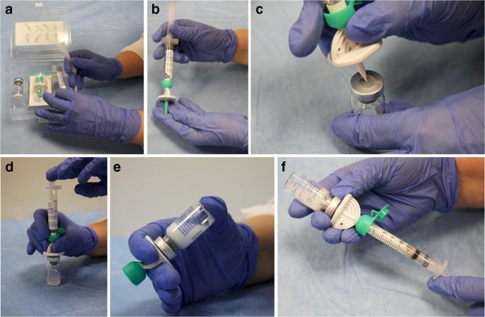
How to do it: Contrast preparation

Slide 52
CEUS guided transthoracic biopsy: Biopsy technique
Sitting/semi-recumbent position
Curvilinear (3-6MHz) or medium frequency linear transducer (9Hz)
B-mode and colour doppler US imaging to identify best biopsy site
Position transducer at the approximate lesion midline to allow an accessible window for biopsy
Inject 2.4ml SonoVue/Lumason (can be diluted in 10ml of saline) followed by saline flush
Pre-scan – 2-3 mins - tumour vascularity, areas of necrosis, access route
Using split screen (contrast + B-mode) inject LA and form incision to allow biopsy needle access
Second bolus of 2.4ml of contrast and in real time, advance biopsy needle into a viable (vascularised) area in the lesion
A third bolus of contrast can be used to assess post-biopsy appearances
CXR 1-2 hours post procedure to exclude PTX (optional)

Slide 53
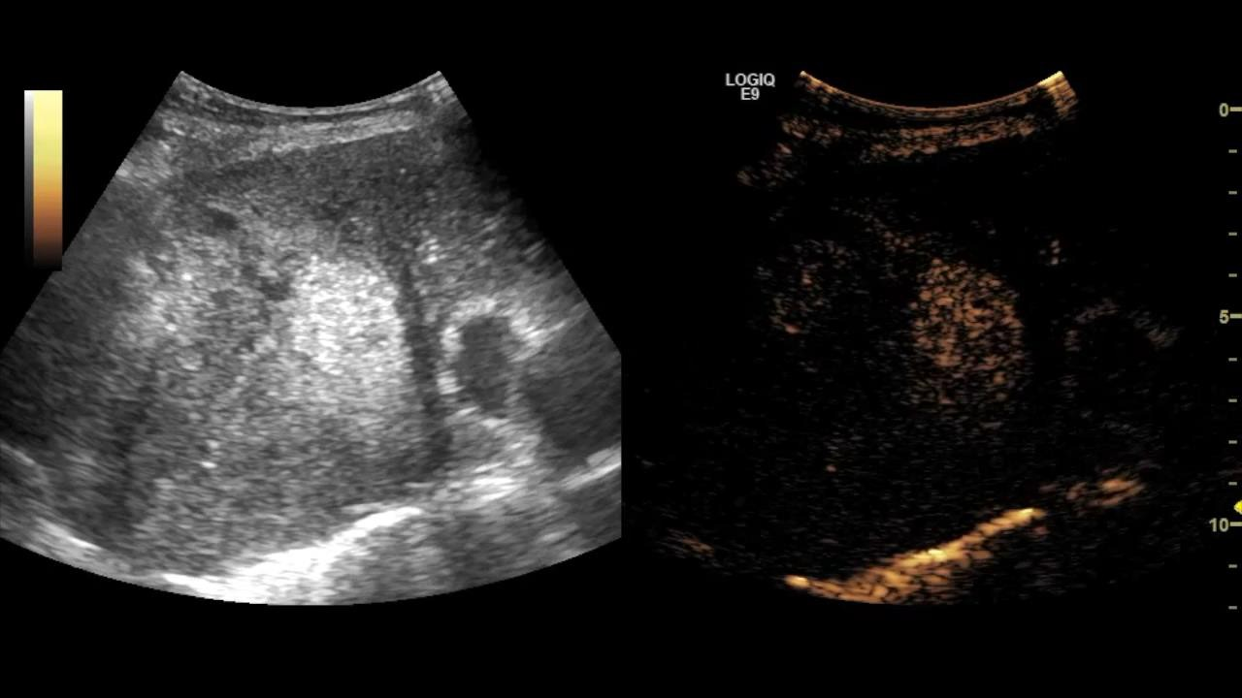
CEUS guided transthoracic biopsy: Biopsy technique

Slide 54
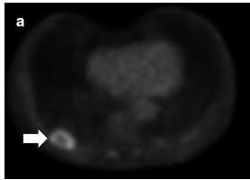
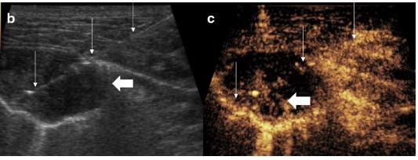
CEUS guided transthoracic biopsy: Biopsy technique
Yusuf et al A pictorial review of the utility of CEUS in thoracic biopsies
Insights Imaging 2021

Slide 55
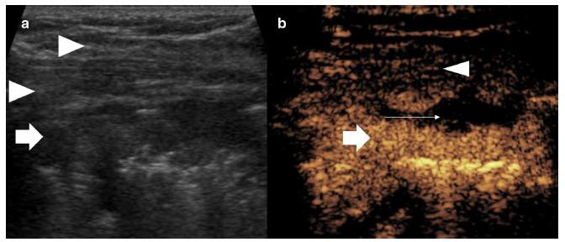
CEUS guided transthoracic biopsy: Biopsy technique
Yusuf et al A pictorial review of the utility of CEUS in thoracic biopsies
Insights Imaging 2021

Slide 56
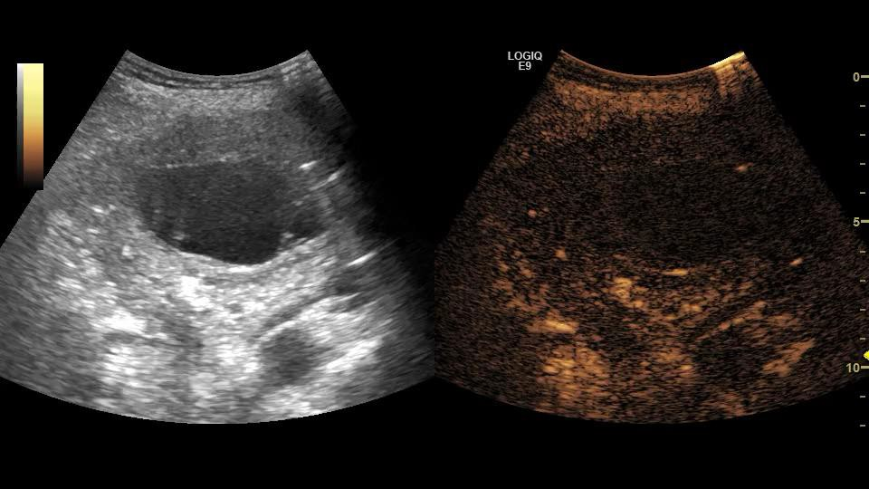
Lung abscess / empyema

Slide 57
Conclusion
With increasing ultrasound expertise amongst respiratory physicians – CEUS should become part of our specialist armamentarium
CEUS is safe with potential advantages over CT/MR in specific situations and the ability
to streamline our diagnostic and intervention pathways
CEUS guided transthoracic biopsy appears to be a promising use case when comparing existing reference modalities
Better studies needed to consolidate the evidence base
Further potential uses intrapleurally and in monitoring response to oncological therapies

Slide 58
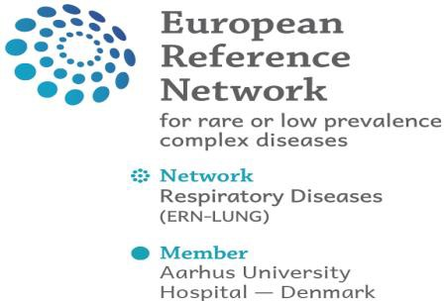




THE ROLE OF TUS IN THE DIAGNOSIS AND MANAGEMENT OF INTERSTITIAL LUNG DISEASES
J e s p e r R ø m h i l d Da v i d s e n , M D, P h D, A s s P r o f
S o u t h D a n i s h C e n t r e f o r I n t e r s t i t i a l L u n g D i s e a s e s ( S C I L S )
P u l m o - R h E u m a F r o n t l i n e C e n t r e ( P U R E ) D e p a r t m e n t o f R e s p i r a t o r y M e d i c i n e
O d e n s e U n i v e r s i t y H o s p i t a l , O d e n s e , D e n m a r k
O d e n s e R e s p i r a t o r y R e s e a r c h U n i t ( O D I N )
U n i v e r s i t y o f S o u t h e r n D e n m a r k , O d e n s e , D e n m a r k

Slide 59
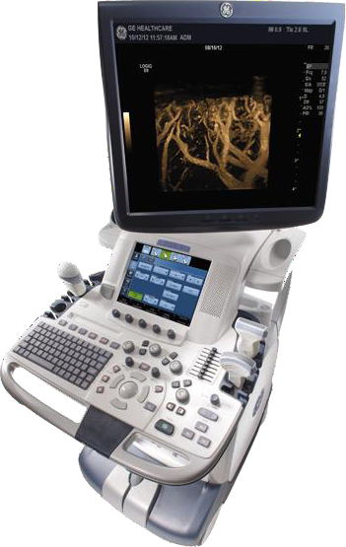
Learning objectives
Current evidence of TUS use in ILD
Which TUS modalities are recommended in ILD diagnostics and monitoring?

Slide 60

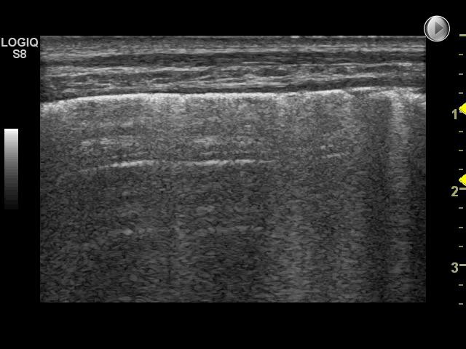
Evidence on TUS use in ILD
Sparse, but increasing since COVID-19
Majority regarding CTD-ILD, few on IIP
predominantly used as pre-HRCT ”screening tool”
‘
Bias and generalisability
mixture of different ILDs
”control groups” – pure healthy controls?
small cohorts
number of scanning zones/LIS (8,10, 14… 72)

Slide 63
The ten basic signs for the
lung part of the BLUE-protocol
The basis pattern the bat sign
The second and third are signs of normality
A-lines , lung sliding
Pleural effusion
quad sign,sinusoid sign
Lung consolidation
shred sign, tissue like sign , dynamic sonographic air bronchogram
Interstitial syndrome
Lung rocket
Pneumothorax
Stratosphere sign and lung point , lung pulse
Lichtenstein D (1997) Lung ultrasound: a method of
the future in intensive care? (Editorial). Rev Pneumol
Clin 53:63–68

Slide 64
B Lines :Interstitial Alveolar Syndrome
The B-line is an artifact having seven characteristic
features Three are constant and four almost constant.
Constant features:
1. This is a comet-tail artifact, always.
2. It arises from the pleural line, always.
3. It moves with lung sliding, always.
Almost constant features (93–97 %)
4. Almost always, it is well defined, laser-like.
5. Almost always, it is long, spreading out
without fading to the edge of the screen.
6. Almost always, it obliterates the A-lines.
7. Almost always, it is hyperechoic.

Slide 65
Z-line should not be…

Slide 67
Physiopathologic Meaning of the B-Lines
3 mm: intralobular septa thickening GGO
7mm : interlobular septa thickening Kerely B lines
The presence of B Line rull out PTX

Slide 68
M- mode B line

Slide 69
Physiopathologic Meaning of the B-Lines
3 mm: intralobular septa thickening GGO
7mm : interlobular septa thickening Kerely B lines
The presence of B Line rull out PTX
The Birolleau Variant
Countless B Lines

Slide 73



ILD definition and classification
Heterogeneous group of diseases (> 200 subtypes)
Similar clinical, radiographic, physiologic, and pathologic manifestations
Affecting the interstitium
Alveolar epithelium
Capillary endothelium
Basement membrane
Perivascular tissue
Perilymphatic tissue
Reffers to proportion of the given subtype developing into PF-ILD
Incidence: 9.4-83.6/100,000 personyears
Hilberg O et al. ERJ Open 2022;8:00597-2021
Raghu G et al. AJRCCM 2022;205:e18-e47

Slide 74




Gold standard in ILD diagnostics

Slide 75



Interstitial syndrome
Definition
Multiple B-lines in at least 2 of the scanned anterior and lateral zones on each hemithorax.
Posterior zones not included in the definition.

Slide 76

Causes - interstitial syndrome
Cardiogenic pulmonary oedema
Non-cardiogenic pulmonary oedema (extravascular lung water)
Interstitial lung diseases
Viral pneumonia
Bacterial pneumonia
ARDS
Acute chest syndrome
Drowning / near-drowning
Lung contusion
……
Lichtenstein DA et al. Chest 2015;147:1659-70
Reissig A et al. J Ultrasound Med 2003;22:173–1

Slide 77




ERS statement (2020)
Laursen CB et al. ERJ 2021;57:2001519

Slide 78




ILD also affects pleura
Wallis A et al. BMJ 2015;350:h2072

Slide 79




Two significant TUS findings in ILD
Zone R1
Zone R1
PLEURAL IRREGULARITY/THICKNESS
B-LINE ARTEFACTS

Slide 80


B-line artefacts (BLA) and lung intercostal spaces (LIS)
32 patients with CTD-ILD
  28 SSc
  2 SS
  1 UCTD
  2 ASS
  2 DM
  1 MCTD
Total LUS score in 50 LIS vs. 14 LIS
  0: < 10 BLAs (normal)
  1: 11-20 BLAs (mild)
  2: 21-50 BLAs (moderate)
  3: > 50 BLAs (marked)
Related to HRCT Warrick score
Guiterrez et al. Arthritis Res Ther 2011;13:R134

Slide 81
Number of BLAs and LIS
32 patients with CTD-ILD
28 SSc
•
•
•
•
•
2 SS
1 UCT 1.
Positive correlation between
↑ BLAs and ↑ ILD severity︎⬆︎
D
S
TD
2 AS
2 DM
1 MC
2. 50 LIS corresponds to 14 LIS
Total LUS score in 50 LIS vs. 14 LIS
  0: < 10 BLAs (normal)
  1: 11-20 BLAs (mild)
  2: 21-50 BLAs (moderate)
  3: > 50 BLAs (marked)
Related to HRCT Warrick score
Guiterrez et al. Arthritis Res Ther 2011;13:R134

Slide 82



Review on BLAs and LIS in ILD
Studies in which total number of B-lines was associated with a high HRCT score
Xie HQ et al. Arthritis Res Ther 2019;21:93

Slide 83



Diagnostic accuracy and N(LIS)
Overall: BLAs with high sens. (85.9%) and spec. (83.9%) for ILD compared to HRCT
TUS method with 14 LIS was recommended (less time consuming)
Usable for RA- and SSc-ILD
Xie HQ et al. Arthritis Res Ther 2019;21:93

Slide 84


Cut-off for number of BLAs (in SSc-ILD)?
40 patients with SSc-ILD
TUS score a.m. Guiterrez (14 LIS)
Gold standard: Asessed by
HRCT (Warrick score)
LUS-score ≥ 10 BLAs ➔
Predictive for significant pulmonary fibrosis in patients with SSc
Tardella et al. Medicine 2018;97:e0566

Slide 85


BLAs in SSc as early marker of ILD?
TUS
Number of B-lines per intercostal space
Positive LUS if:
  > 3 B-lines in 2 neighbour fields
  > 5 B-lines in 1 field
Mean total number of B-lines
  SSc 66±57
  Early SSc 44±40
HRCT
Positive correlation between
↑ BLAs and ↑ ILD severity︎⬆︎
ILD (judged on lobe level)
 | Early SSc | SSc
Sens. | 100% | 100%
Spec. | 53% | 67%
PPV | 59% | 96%
NPV | 100% | 100%
Barskova T et al. Ann Rheum Dis 2013;72:390–95

Slide 86


Distance between BLAs?
HRCT
Disease severity assessesment by Warrick score (0-15 (worse)) indicating lung affection
TUS
BLAs counted per clip
Hasan AA et al. An Thorac Med 2014;9:99-103

Slide 87

Results
Hasan AA et al. An Thorac Med 2014;9:99-103

Slide 88

Clinical usable for phenotyping ILD?
⬆ GGO
⬇ fibrosis
⬇ Distance among BLAs
⬇ GGO
⬆ fibrosis
⬆ Distance among BLAs
Hasan AA et al. An Thorac Med 2014;9:99-103

Slide 89




Pleural irregularity as marker of ILD?
37 patients
21 with ASS
16 with SSc
TUS according to a 72 point score
HRCT according to Warrick score
Pinal-Fernandez I et al. Clin Exp Rheumatol 2015;33:S136-41

Slide 90


TUS performance
5 MHz linear probe
Pleural Irregularity (PI) score based on:
_{PI score =} Points with PI
All points
Subanalyses for SSc-ILD:
PI score > 28.9% (± SD 20.2%) ➔
sens. 67%
spec. 100%
for SSc-ILD on a HRCT
Pinal-Fernandez I et al. Clin Exp Rheumatol 2015;33:S136-41

Slide 91


Clinical usable algorhitm
Suggestion for treatment decision in patients with SSc-ILD
Pinal-Fernandez I et al. Clin Exp Rheumatol 2015;33:S136-41

Slide 92


Study on TUS in IPF (IIP)
31 IPF patients
Positive correlation between HRCT fibrotic score and:
  Number of BLAs
  Pleural thickness (> 2.4 mm)
Manolescu D et al. Clin Intervent Ageing 2018;13:437-449
Manolescu D et al. Clin Respir J. 2020;14:54-63

Slide 93



Monitoring TUS research in IPF
3 years (2019-2022)
Multicenter, prospective, 12 months follow-up
Total number of BLAs
Pleural irregularity score
Pleural thickness score
Monitoring approach
Development of 3 TUS ILS signs
Legué S et al. BMJ Open. 2021;11:e039078

Slide 94








Future: Proposal for screening/follow-up
TUS as part of composite biomarker measures to increase diagnostic / monitoring accuracy?
To the extent best possible to avoid radiation
Approach preceding further diagnostics: ➔
Wang Y et al. Arthritis Res Ther 2021;23:212

Slide 95
Conclusions / recommendations
Diagnosis (TUS for ILD)
Mangement (TUS for ILD)
14 zone/LIS protocols
Monitoring not solid examined, but studies are undergoing according to
Dynamic BLA changes
•
Dynamic pleural changes
BLA
CLINICAL USABLE
CLINICAL USABLE
Indicates ILD
High diagnostic accuracy (sens., spec., NPV)
Increased total number of BLAs ➔ ILD worsening
Cut-off > 10 BLAs predictive of (early) ILD
Distance between BLAs may separate fILD from inflammatory ILD
Warranted
Few studies on IIPs
Solid studies on disease monitoring
Does TUS implementation reduce latency in ILD diagnostics?
•
•
•
Pleural thickness/irregularity
Indicates fibrosis
CLINICAL USABLE
•
>28.9% PI-score ➔ indicator of fibrosis
> 2.4 mm ➔ indicator of fibrosis
Screening/diagnostic tool (“rule-out test”)
CLINICAL USABLE
Initial marker in diagnostic algorithms (SSc, RA, ASS)
Preceding HRCT and lung physiology
Future: TUS as part of composite markers…?

