Slide 1


Slide 2


Patient-Ventilator
Interactions
Clinics in chest medicine
December 2022

Slide 3
INTRODUCTION
excessive sedation accompanying mechanical
ventilation lengthens duration of mechanical ventilation , ICU stay, hospitalization , and possibly predisposes to delirium.
Assisted or supported ventilation, if synchronous
with the patient’s ventilatory muscle efforts, shares
the work of breathing, facilitates muscle recovery
from respiratory fatigue or failure, and avoids
excessive sedation.

Slide 4
synchrony must exist between the flow and pressure delivery of the ventilator and the patient’s effort during all 3 phases of breath delivery: initiation, flow delivery, and termination.
Failure to synchronize breath delivery with patient
effort results in a counterproductive situation
because additional loads are imposed on the ventilatory muscles.
PVD :patient distress and discomfort are increased along with the need for additional sedation.

Slide 5
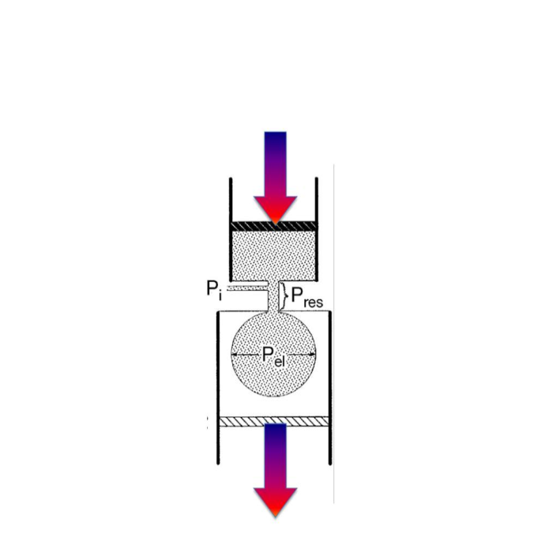
VENTILATORY MUSCLES:
NORMAL PHYSIOLOGY, FATIGUE, AND FAILURE
Lung inflation occurs when a sufficient force is generated largely by the diaphragm to
overcome the elastic and resistive loads imposed by the respiratory system and deliver gas to the alveoli.
Ptot =P el +P res
P tot =(ΔV/C )+ (R × V’)

Slide 6
Fatigue and failure are determined by an imbalance in muscle capabilities against the loads imposed.
In critically ill, these capabilities are impaired by limitations in energy supply, oxygen extraction, metabolic derangements, inefficient weak muscles, and intrinsic PEEP, all further predisposing to fatigue.

Slide 7
Increase in ventilatory muscle demands :
-pressure loads : increase mechanical loads of respiratory mechanics.
-volume loads: increase ventilation needs
Mechanical loads can be described as PTI the single values of work, measure of energy expenditure and predictor of muscle fatigue.
PTI = (Pi/Pi max) (Ti/T tot)
PTI values exceed 0.05 at rest and are rarely greater than 0.1 even with strenuous exercise.
Values greater than 0.15 for the diaphragm predict a finite period before fatigue develops.

Slide 8
In patients with high resistive loads(COPD, asthma, or large airway obstructions) or with high elastic loads(ILD, CPE,ARDS)the required ventilatory pressures (Pi) can be life-threatening.
pressure loads imposed from PVD contribute to the Pi, impeding respiratory muscle recovery. A low Pi max (NMD, malnutrition, or shock )further reduces ventilatory muscles reserves in critical illness.
High MV requirements of acute respiratory failure often increase Vt and shorten the total ventilator cycle time, increasing Ti/T tot.
Central adaptive but potentially counterproductive mechanisms
may influence this pattern, triggering the onset of rapid shallow breathing, which reduces Pi at the cost of increasing the ratio of physiologic dead space and possibly worsening hypercapnia.

Slide 9
INTERACTIVE VENTILATOR MODES AND PVD
Interactive breaths are described as assisted or supported.
An assisted breath is patient triggered and time or volume-cycled, whereas a supported breath is patient-triggered and flow cycled.
Assisted and supported breaths interact with patient efforts through all 3 phases of breath delivery: initiation (trigger), gas delivery (target),and termination (cycling).
Delivered breaths and patient demands must match during all 3 phases to be synchronous. If not, PVD occurs, resulting
in additional imposed mechanical loads.

Slide 11

asynchronous type
Triggering asynchrony
Flow asynchrony
Cycling asynchrony

